Slide 1

First In, Last out:
Story of the Wild Weasels

Slide 2

Today’s Discussion
Vietnam: requirement evolves
The SAM Threat
Project Weasel
Evolution of Weasel airframes, weapons & tactics
Operation Desert Storm
Weasels: Today and Tomorrow

Slide 3
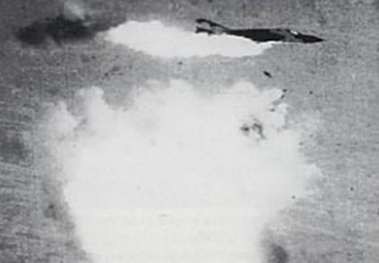
Vietnam Conflict
March of ‘65: Operation Rolling Thunder
  Aerial interdiction campaign in North Vietnam
North Vietnamese Response
  Strengthened defenses: SA-2 SAMs, IADS
  July 24, 1965: USAF F-4C shot down
  July 25, 1965: Drone shot down @ 59k’
Iron Hand: retaliatory SAM strikes
  North forewarned
  Dummy sites, fake missiles
  6 of 46 F-105D strikers lost
Notes:
Vietnam timeline:
- June 1, 1954: Saigon Mil Mission – Psych warfare, paramilitary activities in S. Vietnam
July 21, 1954: Geneva accords – divide Vietnam at 17th Parallel (“not” boundary)
Nov 2, 1963: SVN coup d'état (w/US tacit support) kills Ngo Dinh Diem (autocrat, violent excess vs Buddhist population)
~16,000 US mil / 200 killed
Aug 5, 1964: Gulf of Tonkin (torpedo attack on 2 x US destroyers) Resolution
President authorized to “take all necessary measures to repel any armed attack against the forces of the US”
~23,000 US troops/400 killed
Mar 1, 1966: policy shift from ‘counterproductive’ strategy of attrition to Pacification & Long-Term development of Vietnam’
Largely dismissed by commanders
~185,000 troops/2700 killed
Jan 30, 1968: Tet Offensive – NV/Viet Cong offensive on SVN bases/villages
NVN suffered 60% casualties – US sees Tet as sign of North’s desperation
~485,000 US troops/20,000 killed
Mar 16, 1968: My Lai Massacre – 400 unarmed civ killed by US troops, cover-up, Lt Calley jailed
Jan 27, 1973: Agreement on ending war & restoring peace in Vietnam: US to withdraw w/in 60 days
Mar 29, 1973: Last US military unit leaves Vietnam -- > 58,000 US troops killed
Apr 29, 1975: evacuation of Saigon (7000 US/SVN personnel flown to safety)
Apr 30, 1975: NVN troops enter Saigon; SVN gov’t surrenders unconditionally

Slide 4

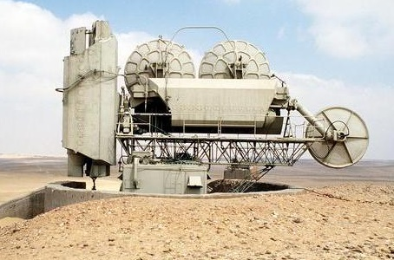
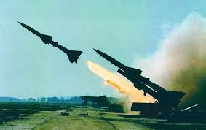
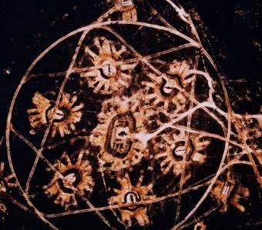
The New Threat: SA-2 SAM System
SAM/AAA/MiG IADS: “Unacceptable losses”
Notes:
FAN SONG Target Tracking Radar
Guidline Missile
IADS: Integrated Air Defense System

Slide 5
Project Weasel
Mission: to rapidly meld the right aircraft, technology and aircrew in order to defeat enemy Surface-to Air Missile (SAM) systems
Immediate solution required
  Modified F-100F
  Advanced avionics
  Specially selected aviators
Notes:
Suppression/destruction of enemy air defenses (SEAD/DEAD) to protect friendly aircraft, enabling them to execute their respective missions (primarily strike)

Slide 6
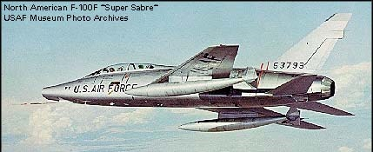
Wild Weasel I: F-100F Super Saber
Two Seat Fighter
Adaptable for new sensors
Multi-mission pedigree
  Fast Fwd Air Control (FAC)
  Escort for F-105
  Search and Rescue (SAR)
  Combat Air Patrol (MIGCAP)
Notes:
Speed mis-match: 420 knots when the thuds were doing 560+

Slide 7
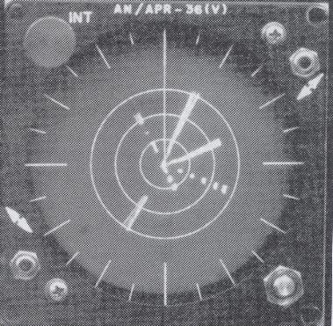
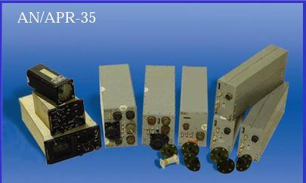
Advanced Avionics/Sensors
Radar Homing and Warning (RHAW) system
  Origins in CIA U-2 Program
  Signal direction/strength
Rapid development/updates
Notes:
APR-35 was the first off the shelf ATI RADAR HOMING AND WARNING (RHAW) RECEIVER used – direction and signal strength
Origins in CIA U-2 program.
The company, ATI, demonstrated rapid, innovative development to continually improve RHAW processing performance throughout (and after) the conflict
Also, equipped most of USAF/USN aircraft with Radar Warning Receivers in coming years

Slide 8

Specially Selected Aviators
10 of most experienced pilots & EWOs
  Reported to Eglin AFB, Oct 1965
  Briefed on the highly classified plan…
“You want me to fly in the back of a little tiny fighter aircraft with a crazy fighter pilot who thinks he’s invincible, hone in on a SAM site in North Vietnam, and shoot it before it shoots me? You Gotta Be Sh***in’ Me!”
-Jack Donovan, B-52 (then F-100) EWO
Notes:
YGBSM, FIRST UTTERED BY JACK DONOVAN UPON HEARING WHAT THE MISSION ENTAILED…REMEMBER THESE EWOS/BACKSEATERS HAD COME OUT OF B-52’S AND HAD NEVER BEEN INVERTED OR PULLED MORE THAN TWO “G’S”
-- Quickly adopted as the unofficial motto of the Wild Weasels
-Hurriedly trained (~ 1 month), deployed, arrived @ Korat, Thailand on Thanksgiving day, 1965
-Cat/mouse game began, initially in border region between Vietnam & Laos (gather ELINT, build SA)

Slide 9
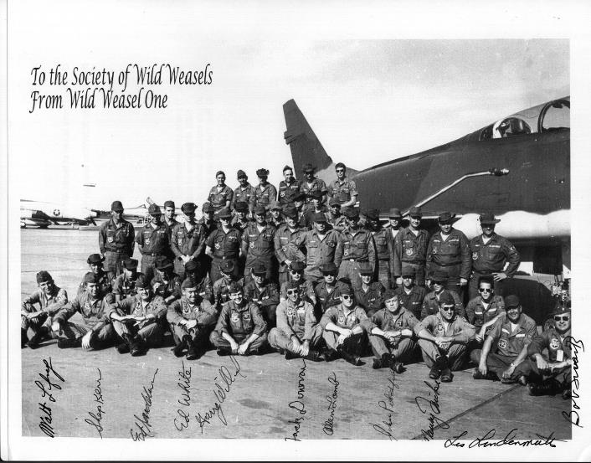
Wild Weasel I – the Pioneers
Notes:
Here are the first Wild Weasels…..
- Under the must treacherous conditions, they laid the foundation for what would become an ongoing requirement for all future offensive air operations
These warriors took what they were given and devised tactics to locate N Vietnamese SAMs using different methods…
Direction finding/triangulation;
Get a SAM to launch on them & follow the smoke trail back
…and then attack them directly using bombs/rockets/guns, or have F-105s attack the site
If the site was launching on Weasels, it wasn’t engaging strikers
Fear of being located based on their emissions drove hesitancy for SAM operators…again, protecting strikers.

Slide 10
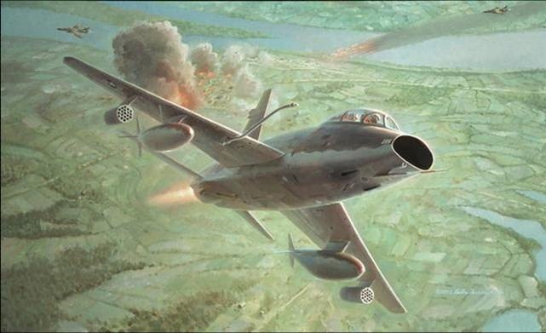
First SAM Kill: Dec 22, 1965
“We knew now that, yeah baby, every time you turn that SAM on your hand may tremble because there may be a Weasel coming right down your throat.”
Al Lamb, Lt Col (ret), USAF
Notes:
On 22 December 1965 Nose gunner Al Lamb and his Bear Jack Donovan leading a flight of 4 Thuds locate and attack a Sam Site

Slide 11
F-100 Wild Weasel Tactics
Locate SAMs:
  Very rough DF/triangulation
  “Distract” SA-2s, entice launches, follow smoke back
Once located, SAM attacked by Weasels or passed to Thuds for kill
Lessons:
  F-100 Weasels fuel-limited
  Speed difference with Thuds impacted support
Last F-100 sorties flown Jul 1966
5 of 7 F-100 Weasels Lost
Notes:
These warriors took what they were given and devised tactics to locate N Vietnamese SAMs using different methods…
Direction finding/triangulation;
Get a SAM to launch on them & follow the smoke trail back

Slide 12
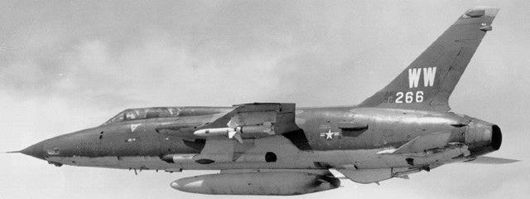
F-105F/G Wild Weasel
In-theater May, 1966
Improved avionics/RHAW; internal jammers
Stand-off weapons
  AGM-45 Shrike
  AGM-78 Standard ARM
Notes:
Stand-off weapons made the mission no less treacherous

Slide 13
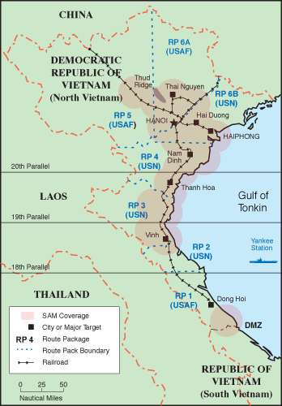
North Vietnam SAM Coverage
Aug 1966
Notes:
Shown here are the Route Packages (ROUTE PACKS) and associated SAM Coverage
Over 100 SA-2s blanketed key targets by Aug 1966

Slide 14
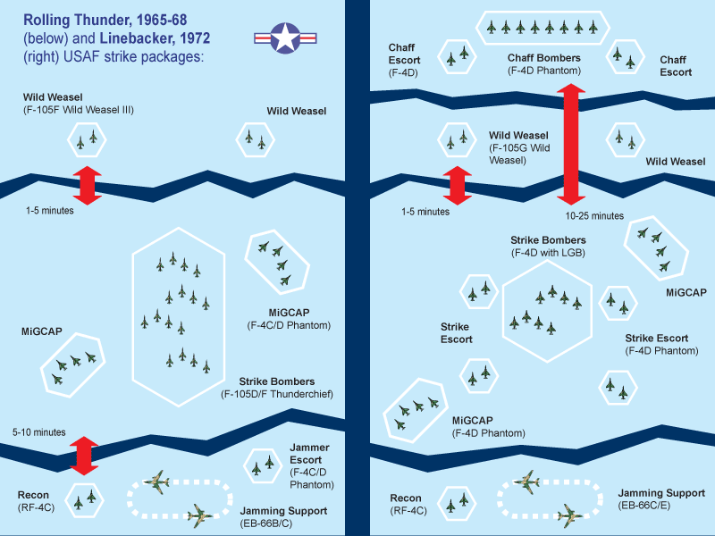
Strike Force Package
Weasels (F-105F/G)
MIGCAP (F-4’s)
Strike Force (F-105D)
Jamming Support (EB-66)
Recon (RF-4C)
Tankers ( KC-135)
SAR & Jolly Greens
ABCCC ( C-130)
Weasels First In, Last Out…
Notes:
Wild Weasels: First In, Last Out

Slide 15
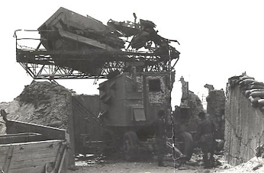
F-105 Wild Weasel Success, Cost
Destroyed over 40 SAMs
Weasel threat:
  Caused SAM operators to shut down radars
  Enabled reduced threat to strike ops
Cost:
  Dozens of Weasel aircraft downed
  42 aircrew killed, missing or POWs
Wild Weasel Successes Validated Need for Dedicated Weasel Mission, Improvements
Notes:
3322 Aircraft Lost
205 by SAM’s
90 by MiG’s
3265 Fatalities
497 POW’s

Slide 16
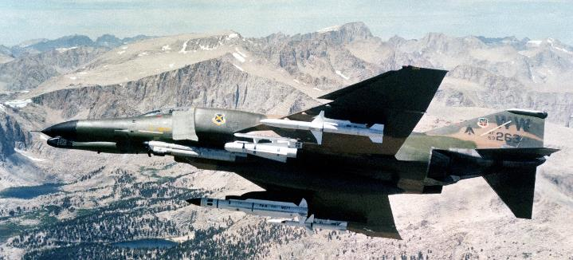
Post Vietnam: 1975-1990
AF kept the dedicated Weasel mission
Upgrades to F-105G
F-4G Advanced WW fielded in 1978

Slide 17
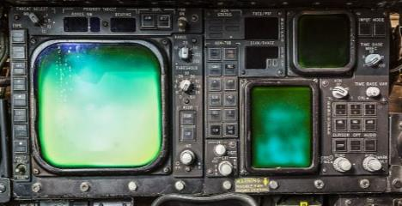
F-4G Advanced Wild Weasel
Modified 116 F-4Es
Replaced gun with receivers, signal processors
AN/APR-38 Radar Attack Warning System (RAWS)
  Detect, identify, locate threat emitters
  Integrated dynamic weapon envelopes/handoffs
  Upgraded to APR-47 ~1988
Notes:
APR-38 used the 8k memory Homing and Warning Computer (HAWC)
APR-47 replaced HAWC with the 32k memory Weasel Attack Signal Processor (WASP)

Slide 18
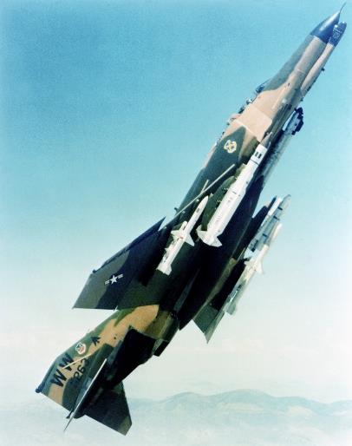
F-4G Anti-Radiation Missile Evolution
AGM-45 Shrike
  Frequency band specific
  No off-axis capability
  Relatively short range
AGM-78 Standard Arm
  Broader frequency range
  Off-axis capability
  Long range
AGM-88 HARM
  Long range, off axis
  Location/emitter specificity

Slide 19

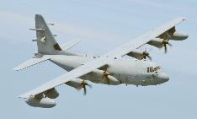
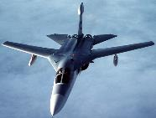
WW Testing & Training Innovation
F-4G Test: tight relationship w/engineers
  Responsive problem fixes
  Turned bar-napkin capabilities into reality
Realistic tactics training
  Red Flag exercises
  Electronic Combat Triad
  Make/correct mistakes in peacetime
Realistic Testing/Training
Ensured WW Readiness

Slide 20
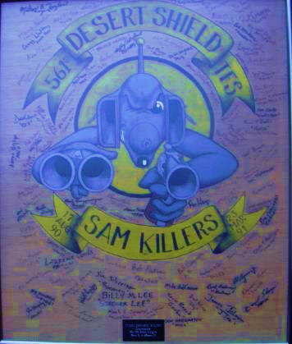
Desert Shield: SEAD Campaign Prep
Planning/Training vs. “most extensive IADS”
Significant coord: jammers, F-117s, cruise missiles, helicopters, drones
“Phantom Range”
Missions:
  SEAD
  Direct Support

Slide 21
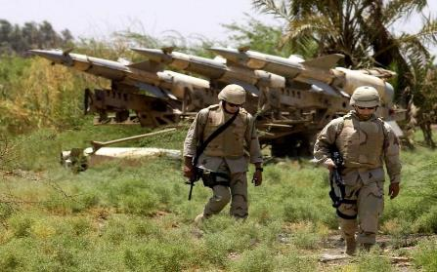
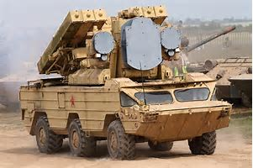
Baghdad Threat: Mission Night One
Over 150 radar-guided SAMs: SA-2s, SA-3s, SA-6s, SA-8s, IHAWKS, Rolands
300+ AAA: 23 mm, 37 mm, 57 MM, 85 mm, 100 mm

Slide 22
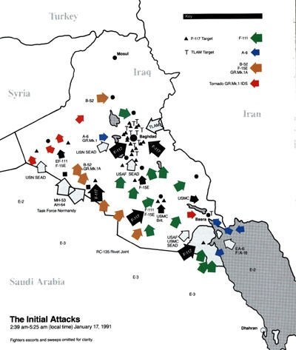
Desert Storm: Night One Campaign Plan
Pentagon Models: “30% Attrition”

Slide 23
Mission Night One: Baghdad
Air Force in the East, Navy in the West
6 Drones up the middle 2 minutes early
Air Force Package
  12 Wild Weasels, 3 EF-111s, 4 F-15Cs
US Navy Package
  4 CAPs of A-6, EA-6B, F-14s, F-18s
  38 Drones and 42 HARMs
Resounding Success:
Targets Hit, No A/C Lost to SAMs
Notes:
CAP (Combat Air Patrol)

Slide 24
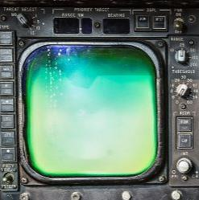
Mission Video: Weasel vs. SAMs
Day 5: 2 x F-4Gs; 2 HARMs/3 tanks each
Direct Support Mission: 3 x Italian Tornados bombing targets at Ali Al Salem AB (Kuwait)
SA-3 short-range engagement followed by longer-range SA-2 engagement
AAA

Slide 25
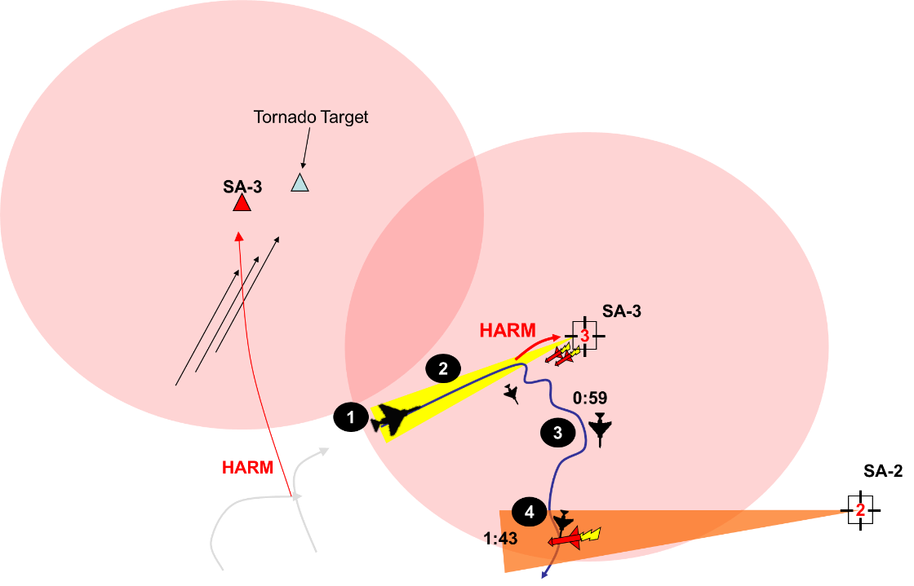

AAA
Jettison Tanks

Slide 26
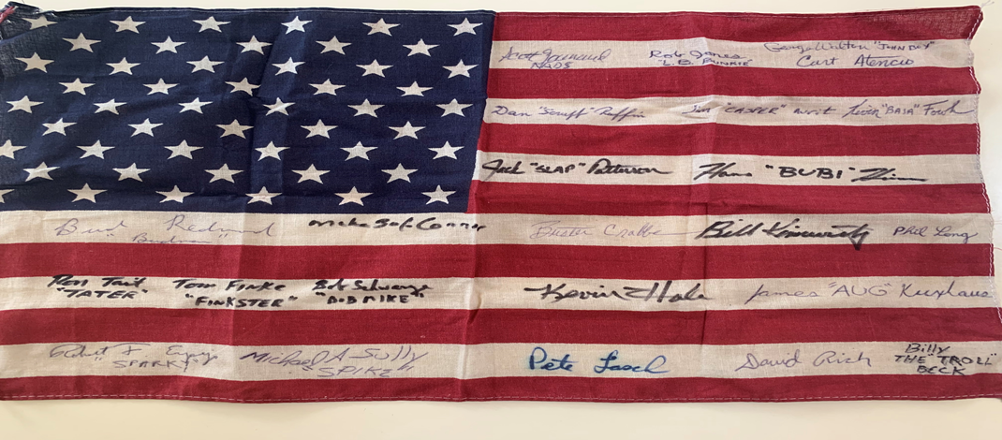
DESERT STORM Lessons
Fight like you train--believe in your team
Know your systems and make ‘em better
Adapt faster than the enemy--don’t fight the last war
Know war and study wars--look for innovators

Slide 27
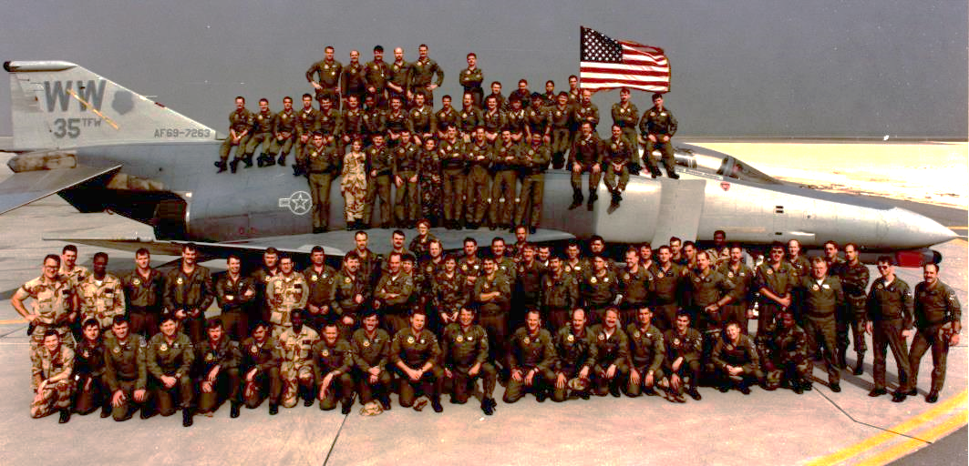
DESERT STORM:
35th TFW(P) Wild Weasels
Notes:
These are the men and women of the 35th TFW (Provisional) who took part in the greatest, most effective SEAD campaign in the history of the United States. They learned from their predecessors, devised optimum tactics to protect coalition aircraft, revised those tactics to handle changes in the threat environment, and closely coordinated with supported packages to maximize support.
Retired in 1996, the legacy of the F-4G Wild Weasel was passed to the F-16CJ community. Airframe, technology, and most important, aircrew dedicated to knowing the threat and employing optimum tactics against that threat to provide Air Superiority/Supremacy was now their charge.
Here to talk about just that is Col Brandon “Mascot” McBrayer.

Slide 28
Weasels: Today and Tomorrow
Brandon “Mascot” McBrayer

Slide 29
Mission Night One: Baghdad
Air Force in the East, Navy in the West
6 Drones up the middle 2 minutes early
Air Force Package
  12 Wild Weasels, 3 EF-111s, 4 F-15Cs
US Navy Package
  4 CAPs of A-6, EA-6B, F-14s, F-18s
  38 Drones and 42 HARMs
Resounding Success:
Targets Hit, No A/C Lost to SAMs
Notes:
CAP (Combat Air Patrol)

Slide 30
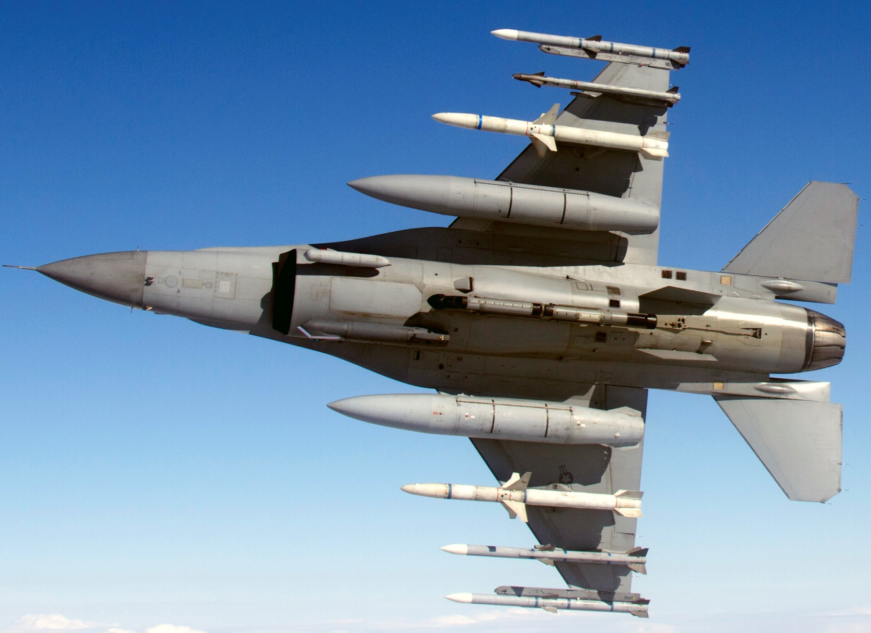
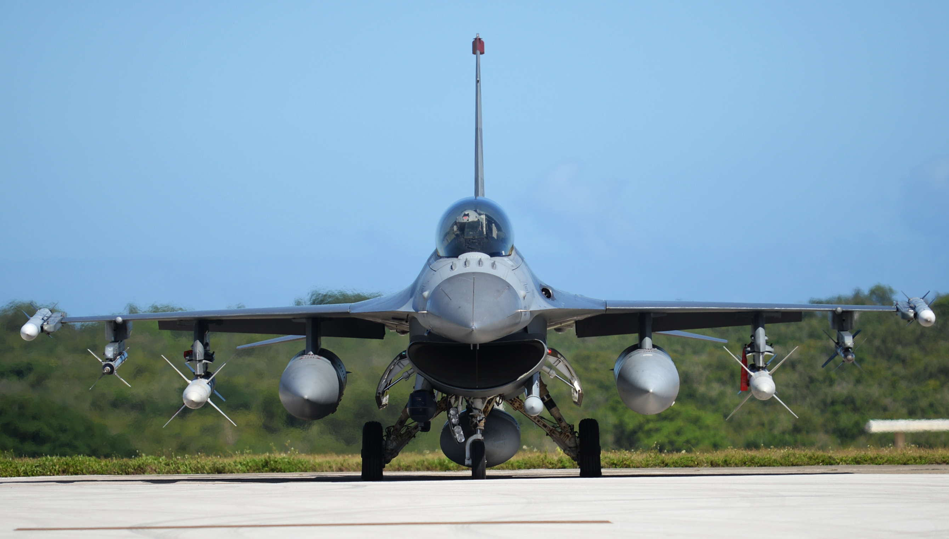
Block 50/52 F-16CJ
Sqds: 1x Spang, 2x Misawa, 3x Shaw, 2x ANG
Notes:
Pictures to show Block 50 F-16 with dual carriage HTS and ATP. SEAD loadout of 2x AGM-88

Slide 31
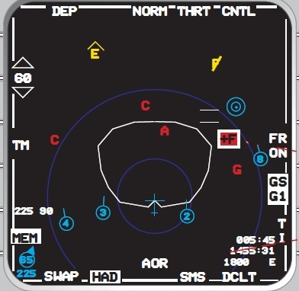
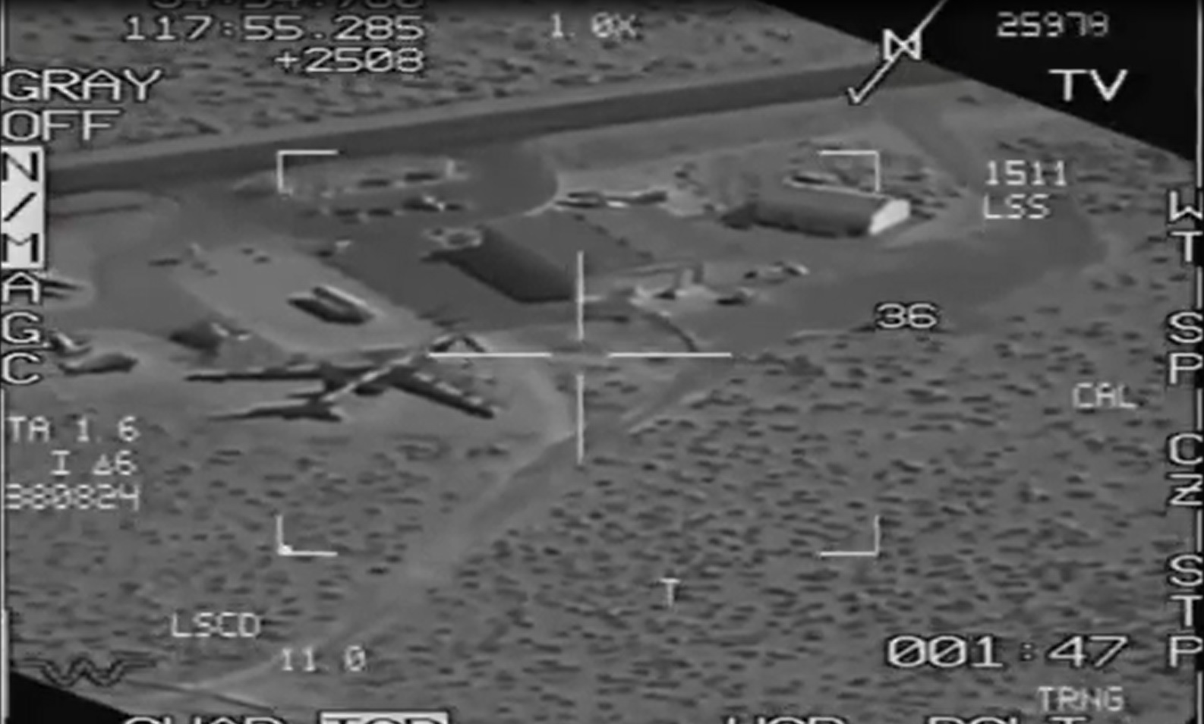
F-16 Sensors
HTS / ATP
LINK-16
JHMCS / NVG
Notes:
HTS for single-ship geolocation
ATP to help visual search or VID
LINK-16 adds multi-ship geolocation and data sharing
JHMCS and NVG allow pilots to see threat and cue systems to visually-aquired threats

Slide 32
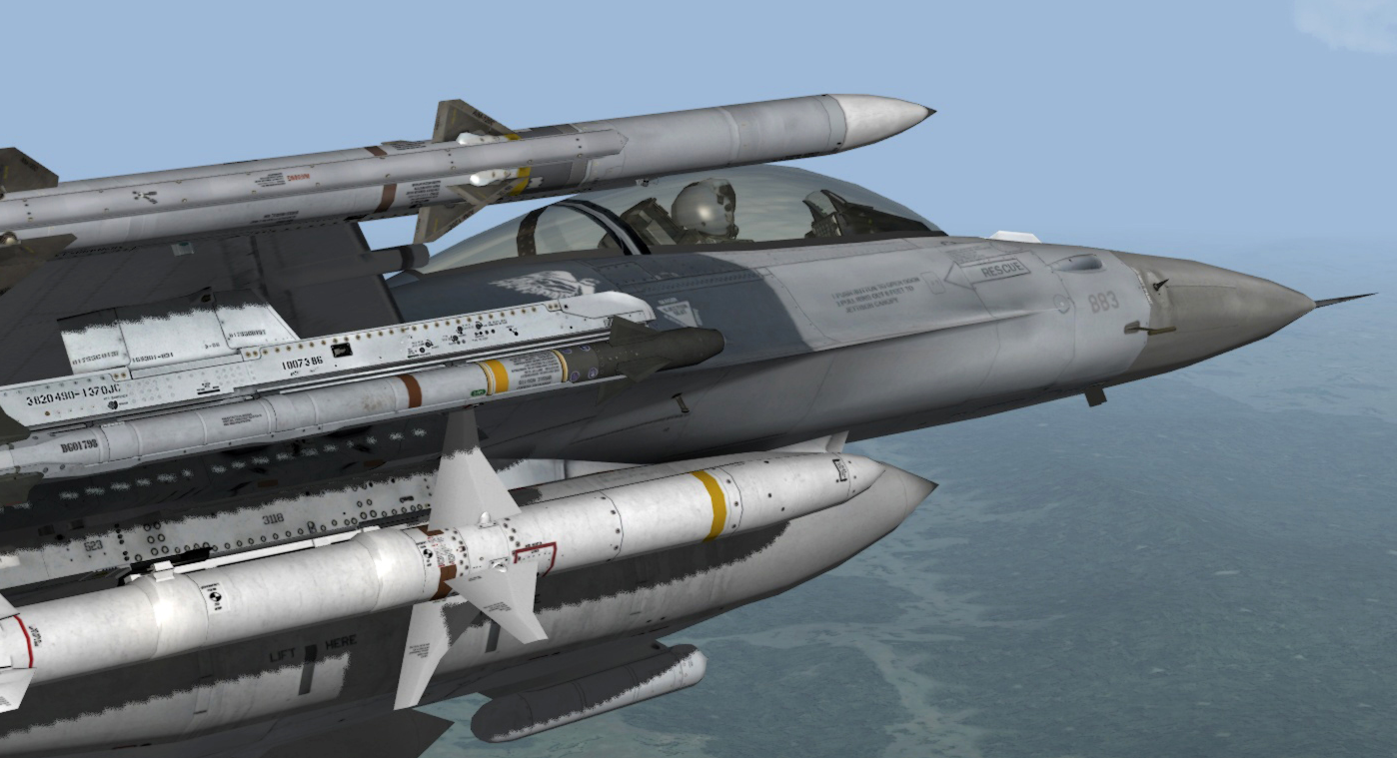
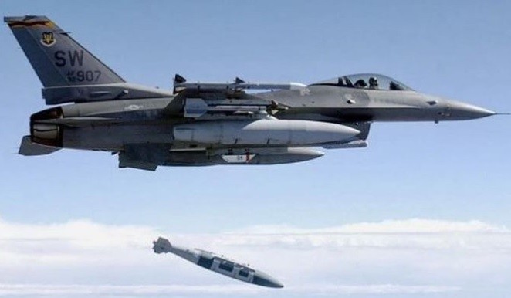
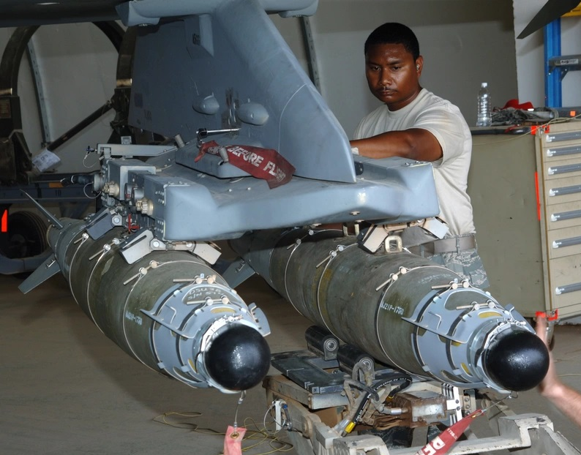
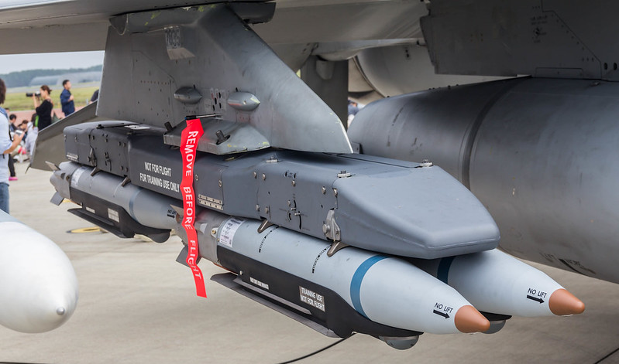
F-16 Weapons
AGM-88
GBU-31 / 54 / 39
MALD / ECM
Notes:
AGM-88 guides on threat emissions and has limited ability to hit if threat off air. Getting better with upgrades.
GBU-31 great against Strat SAMS and 54 or 39 better against Tactical SAMS or any SAM with better known coordinates
MALD for decoy and ECM for self protection

Slide 33
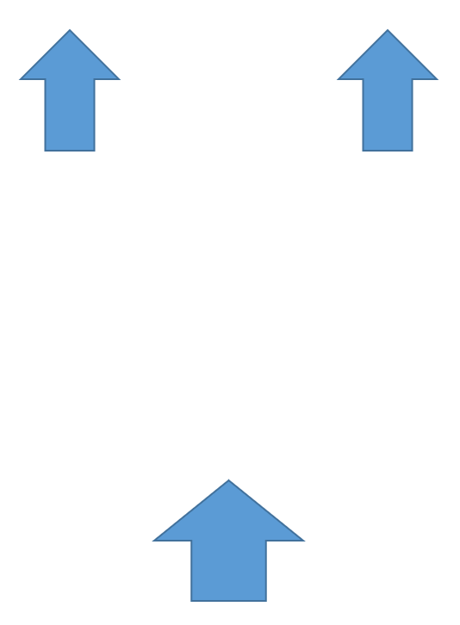
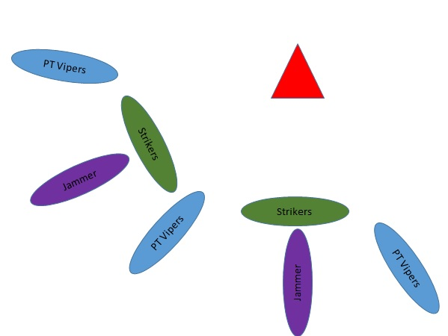
Tactics (Avoid, Suppress, Destroy)
CAP / Flow Through
(D)SEAD
CRISTAL
MULTI MDS
Notes:
CAP or Flow Through as described in Vietnam or Desert Storm
CRISTAL allowed quicker geolocation and defense in depth
MULTI MDS could also work together to sanitize an area if dedicated to DEAD

Slide 34
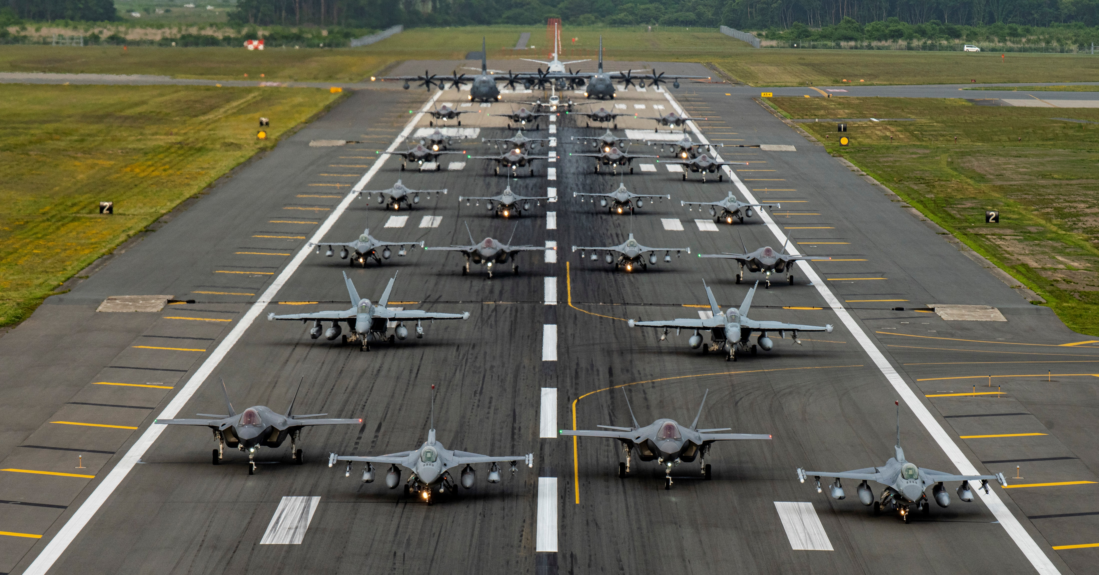
4th, 4.5th, & 5th GEN
Notes:
4th gen – Vipers
4.5th gen – E/F-18G Growlers with ESA and EA/EP pod
5th gen – smaller RCS to deny/delay acquisition by SAM

Slide 35
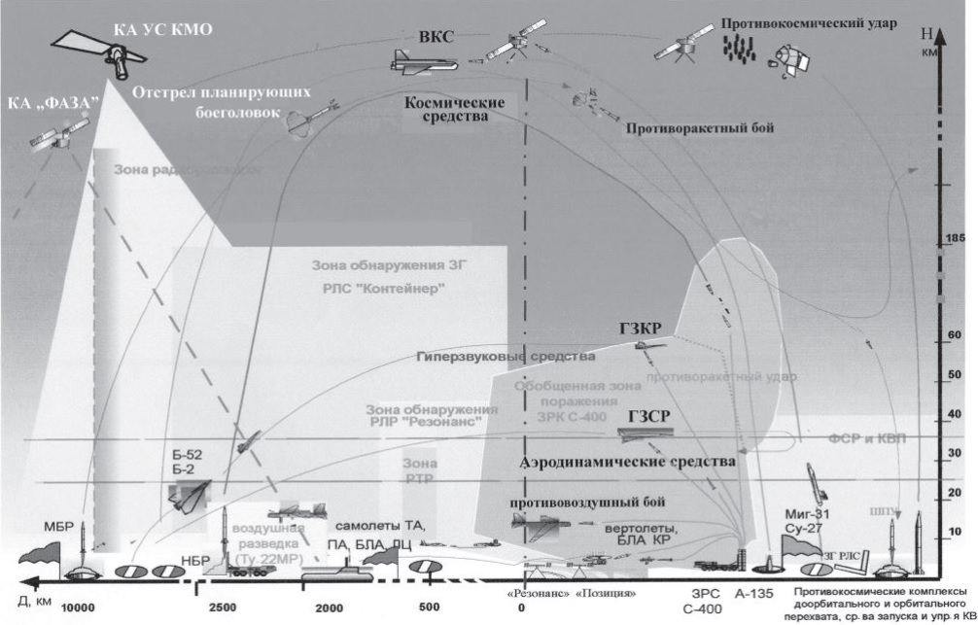
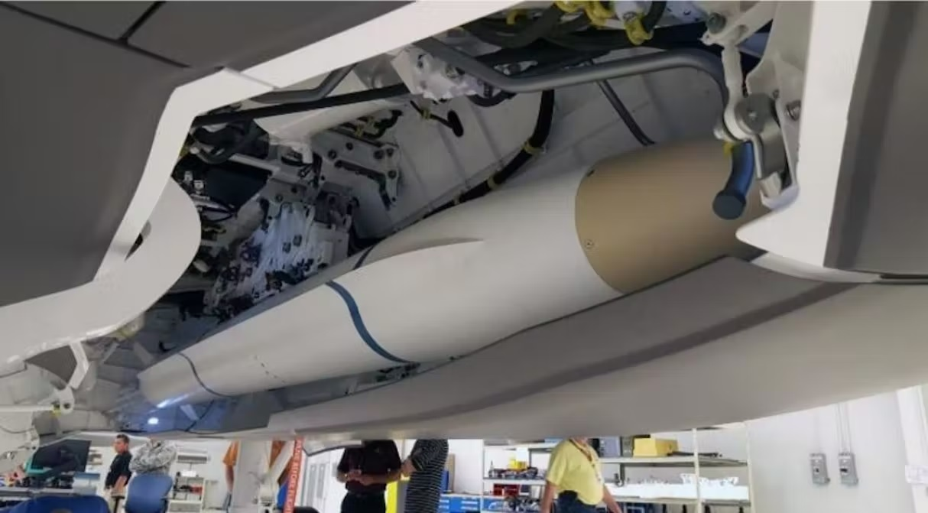
F-35 and multidomain
Sensor Fusion / EM / Weapons
Space and Cyber
Notes:
F-35 and multidomain team help defeat the IADS, not just the site shooting you or those you are protecting

Slide 36



Questions?
Notes:
The First In, Last Out mindset coupled with being the expert on how to Avoid, Suppress, or Destroy threats to the strike package. Knowing your systems and more about the enemy’s IADS than they know.

