Slide 1
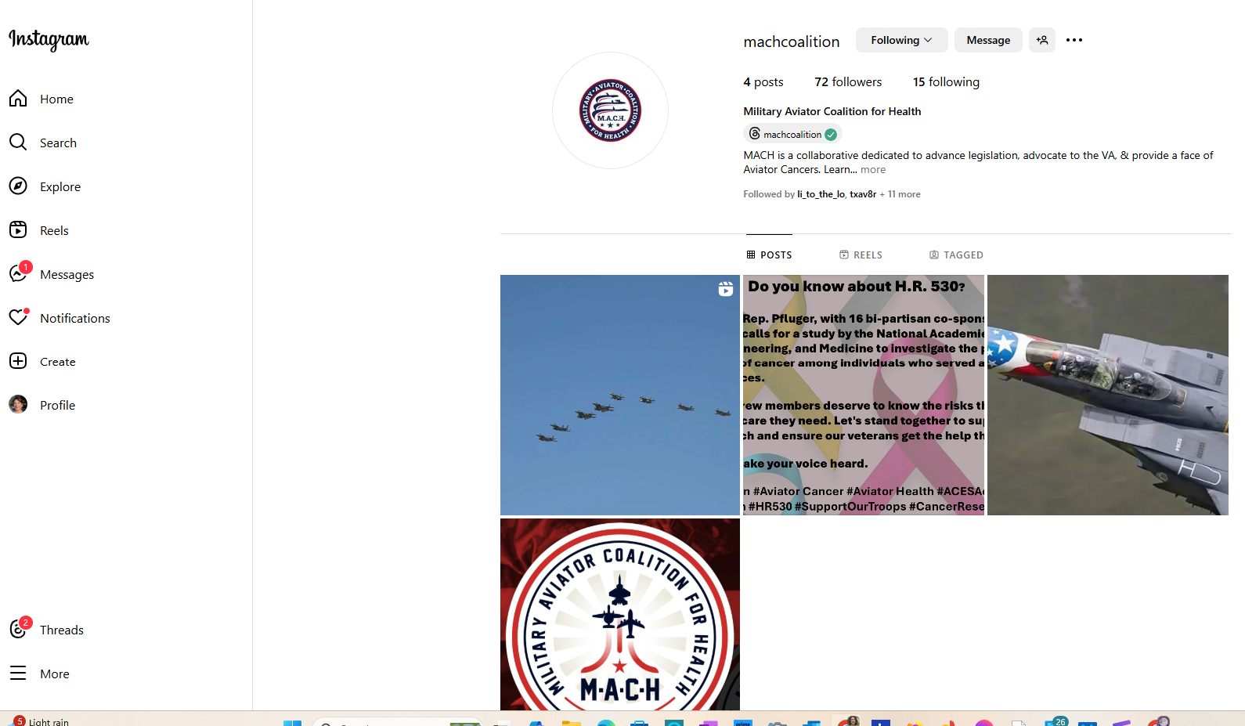

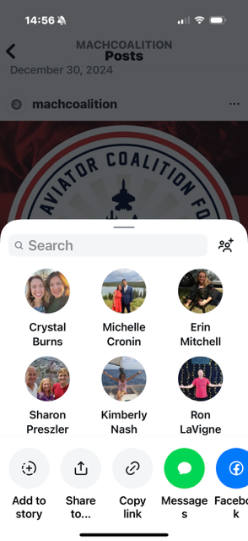
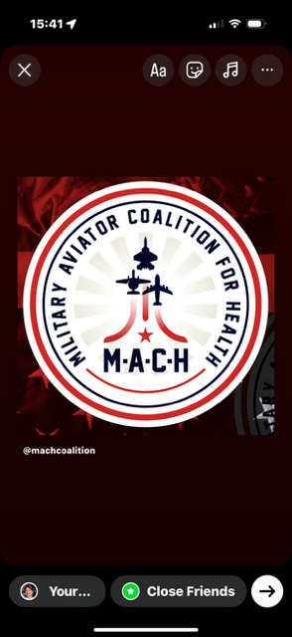
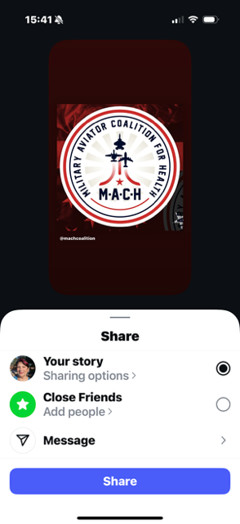
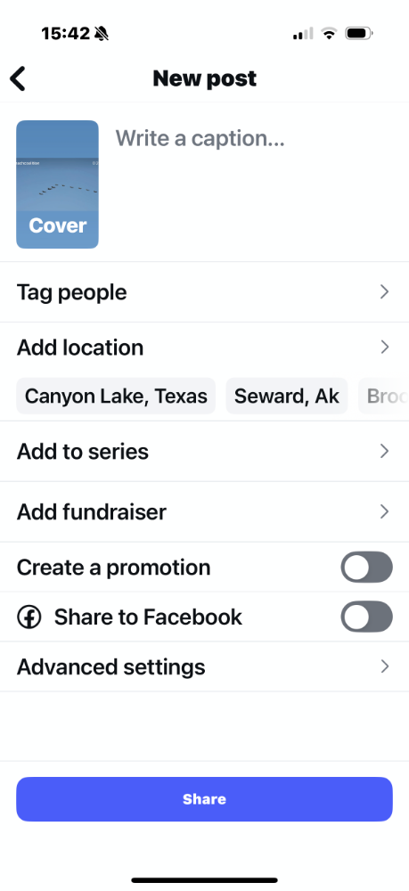
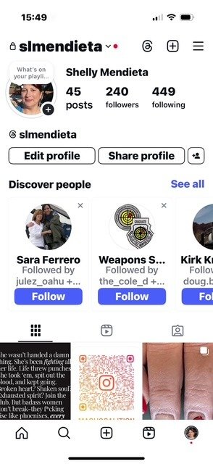
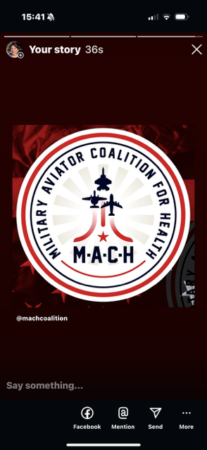
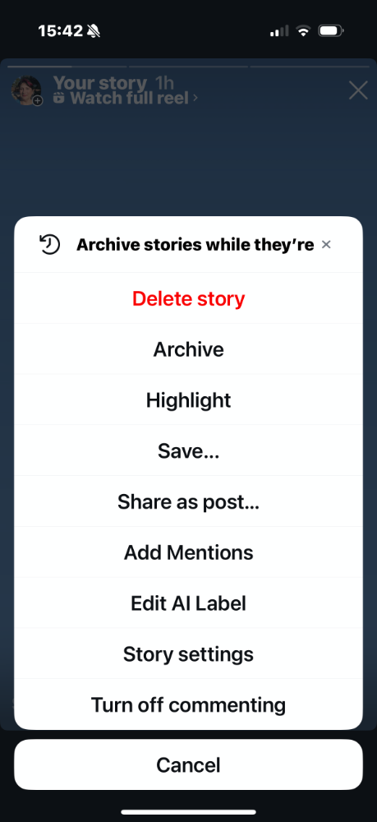

1. From your phone - Open Instagram and search for Mach Coalition
2. Select the post you want to share
3. Select the paper airplane
4. Select Add to story
5. Select the →
5. Select Share
Note: Stories last 24 hours
Mach Coalition Instagram:
https://www.instagram.com/machcoalition?utm_source=ig_web_button_share_sheet&igsh=ZDNlZDc0MzIxNw==
5. Go back to you profile and Select your picture in the top left
6. This brings up stories. Select More …
6. Select Share as post,
This remains unless you delete it
7. Add the comments from the MACH post or add the Mach Coalition link
8. Select Share

