Slide 1
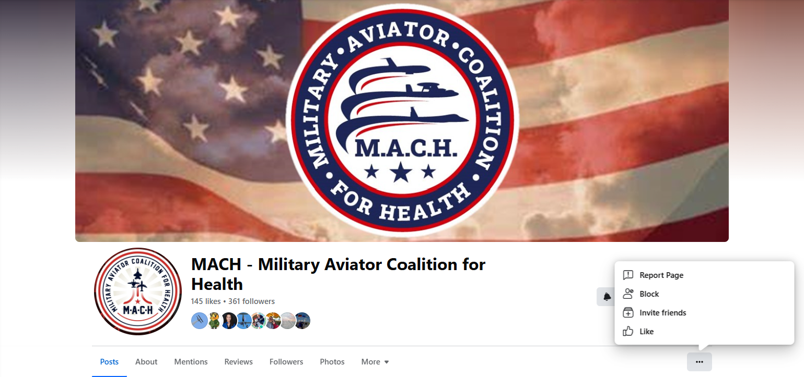
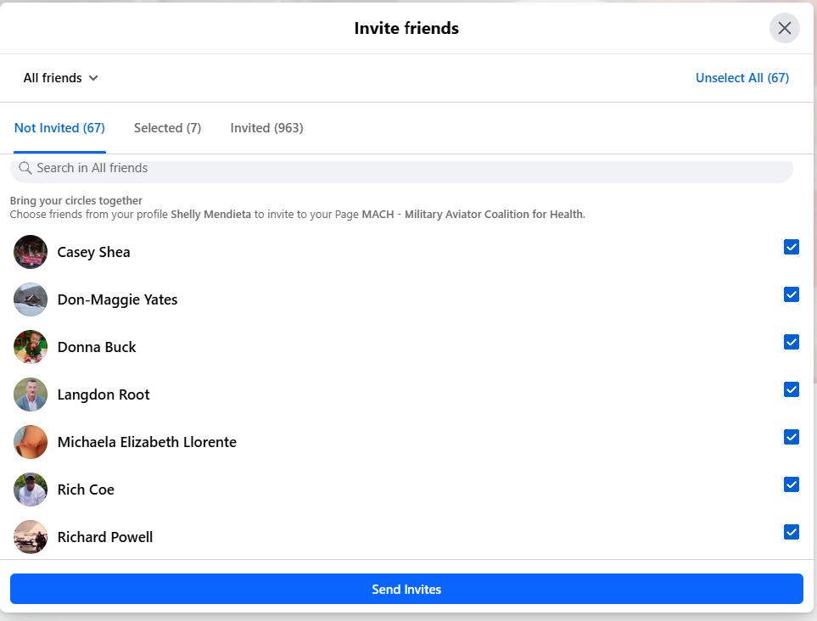
3. In the top right “Select All” or if you prefer select specific friends
4. Send Invite
Go to MACH Facebook Page
Click in the “…” and then click “Invite friends:
5. Share MACH page on your other group pages:
https://www.facebook.com/profile.php?id=61570257942482

