Slide 1
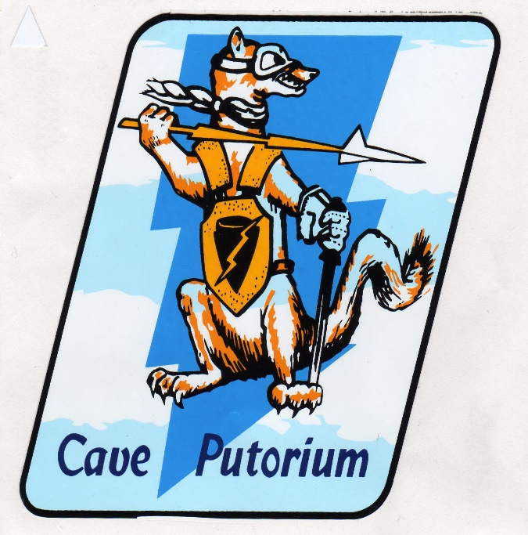
First In, Last out:
Story of the Wild Weasels
Lt.Col. Stan Goldstein USAF (RET) Wild Weasel #415

Slide 2
Why we are here today !

Slide 3
Today’s Discussion
What is a Wild Weasel
Battle of the Beams
The Fight for SVN
The Sam Threat
Countering the Sams
The First Sam Kill
Weaseling
The Wild Weasels Today

Slide 4
What is a Wild Weasel
Specially Trained Crews
Fighters with Special Sensors
Weapons
Tactics
Mission: to kill/suppress SAM’s
Contribute to Air Superiority

Slide 5
Battle of the Beams
WW II –introduction of RADAR
  The Wizard War---Carpet and Window
  Ferret Aircraft
  First SAM
Korea
  Radar Directed Weapons/Search lights
  Ferrets and Hunter Killers

Slide 6
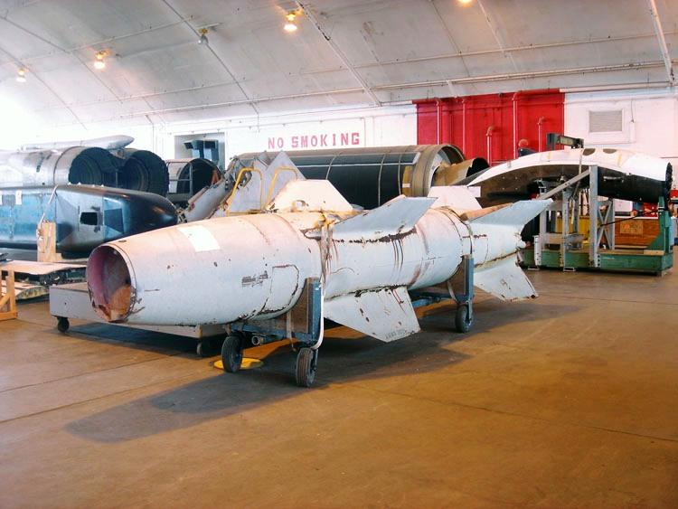
Nazi Wasserfall SAM
  6
10/08/19

Slide 7
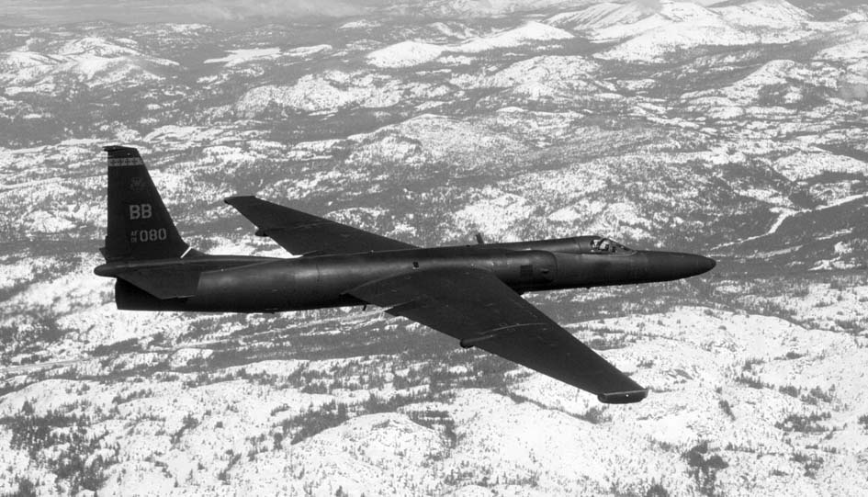
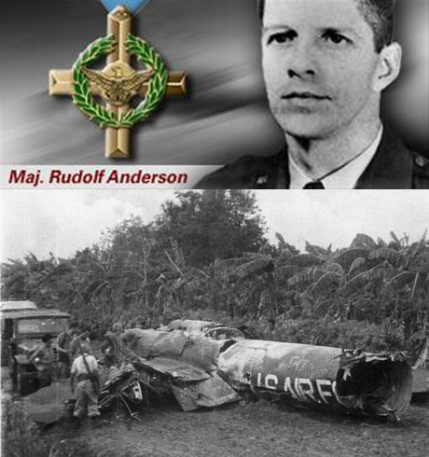
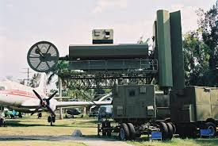
Cuban Missile Crisis
  7
10/08/19

Slide 8
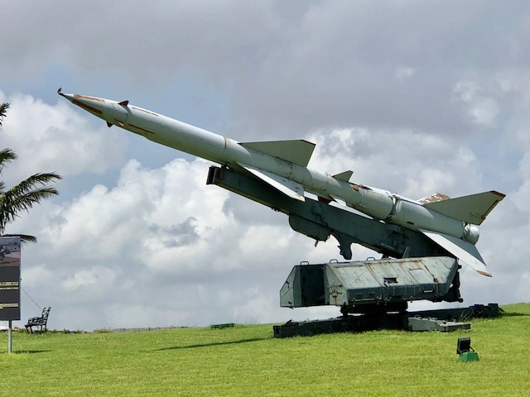
Cuban SA-2 SAM Havana
  8
10/08/19

Slide 9
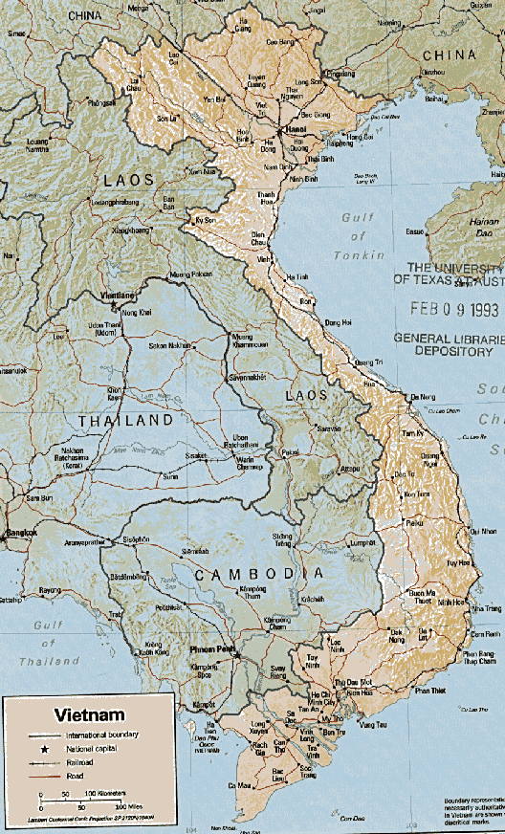
Vietnam
Notes:
Our Story Starts here.

Slide 10
South Vietnam is the Prize
South Viet Nam
Ho Chi Min
LBJ
JCS
Notes:
Ho chi min grand strategy called for the unification of Vietnam that was separated by the Geneva Agreements of 1954… LBJ following the dulles policy a of the domino theory and JFK actions was TRYING TO KEEP THE South Vietnamese independent. Although Eisenhower and others had said that key to the area was Laos.
The NAVAL and AIR components saw Victory being achieved by directing force directly against NVN. They thought that Air power could do it if unleashed against the north…. The Army advocates wanted to insert ground forces.

Slide 11
The Threat Evolves
NVN Air Defenses
  Prepared to fight a Korean war
  Surprised by Tactical Air
  Request Help from China/USSR
The SA-2’s & MiG’s arrive
Increased # of light/medium AAA batteries

Slide 12
The SAMs are coming
CIA U-2 observe SAM Site construction
JCS calls for Site Destruction
EB-66’s pick up SAM Signals
JCS calls for Site Destruction

Slide 13
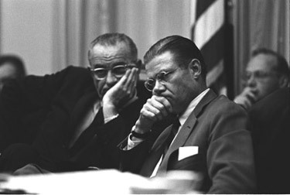
LBJ & McNamara
Plan for Rolling Thunder – a gradual response
Notes:
Lbj and macnamara plan a gradual war….Rolling Thunder that would only apply pressure a bit at a time… starting in the lower route paks and then going north… They chose the targets, the TOT’s , the ordnance and the routes… But worst of all they dictated the ROE”s ( Rules of engagement) that preclude our attacking of the Sams before they fired at US Forces….

Slide 14
LBJ Micro-Management
Target Selection
Target ordnance
Target TOT
ROE- no attack of Sam’s or MiG’s
Prohibited no-fly zones
GUARANTEED FAILURE

Slide 15
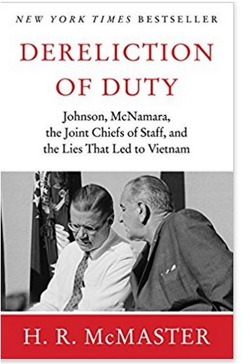

Slide 16
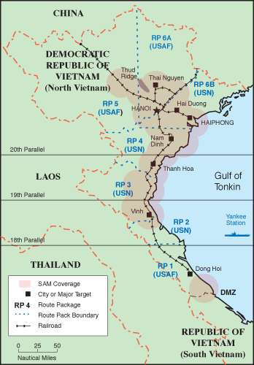
NVN Route Packages
Notes:
SHOWN HERE ARE THE ROUTE PACKS AND THE ASSOCIATED SAM COVERAGE

Slide 17
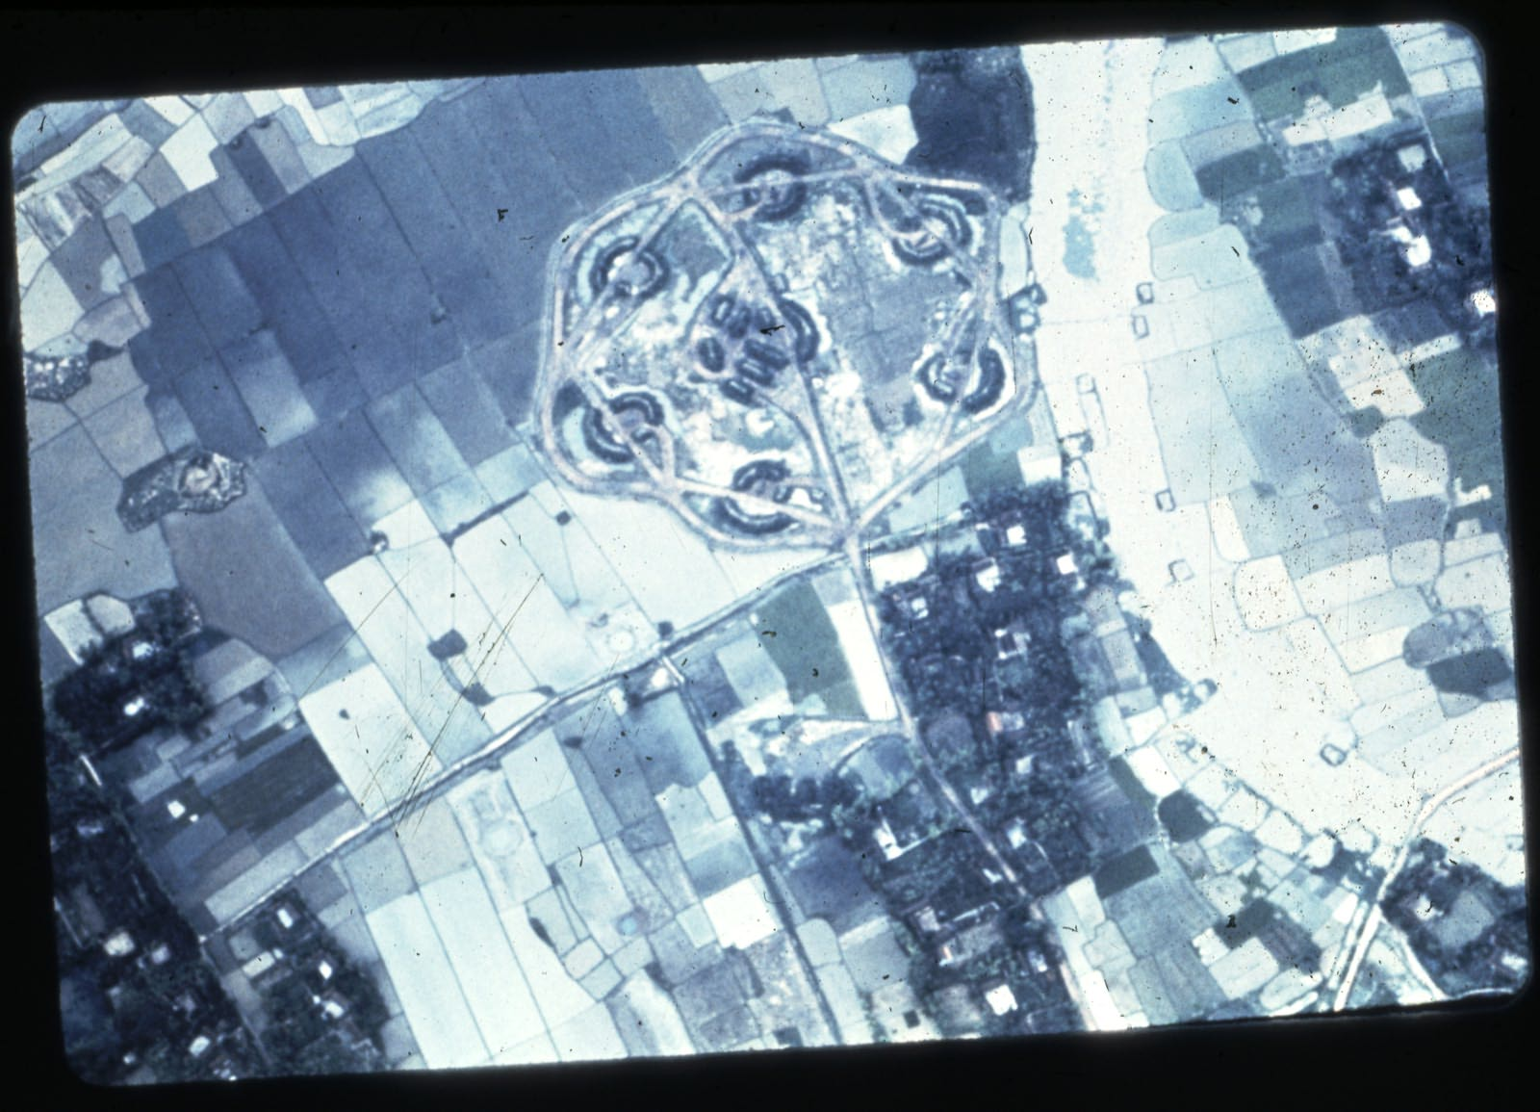
Classic SA-2 (Fansong) site

Slide 18
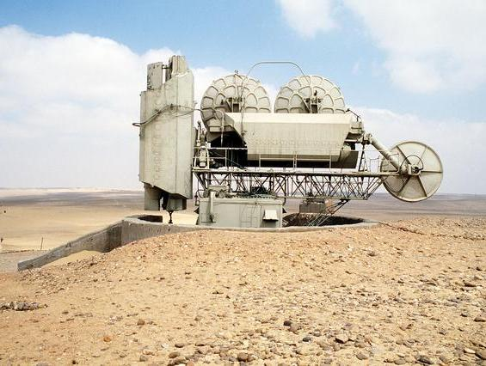
SA-2 FANSONG Radar

Slide 19
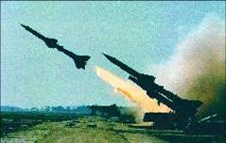
SA-2 COMING OFF the Rails
Notes:
Radar directed First kill is U-2 pilot over Cuba although there is some rumors of the Russian shoot down of the U-2.
Real threat posed by the Sam if alllowed to operate with impunity is that it would drive the attacking Tactical fighters in to
the kill zone of the smaller AAA 23,37 mm guns… and make target ID harder.
Reason for weasels coming into being…
Reason for weasels coming into being…

Slide 20
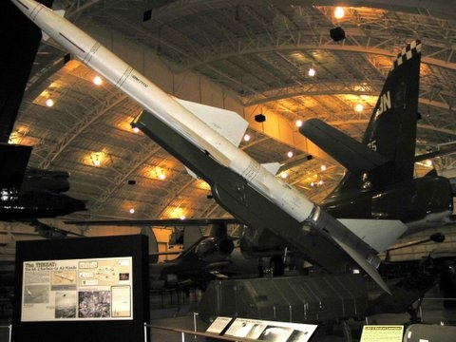
SA-2 Guide line missile at WPAFB

Slide 21
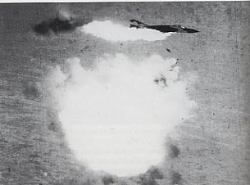
SAM KILL July 24th 1965
The Game begins
Notes:
Retatalatory

Slide 22
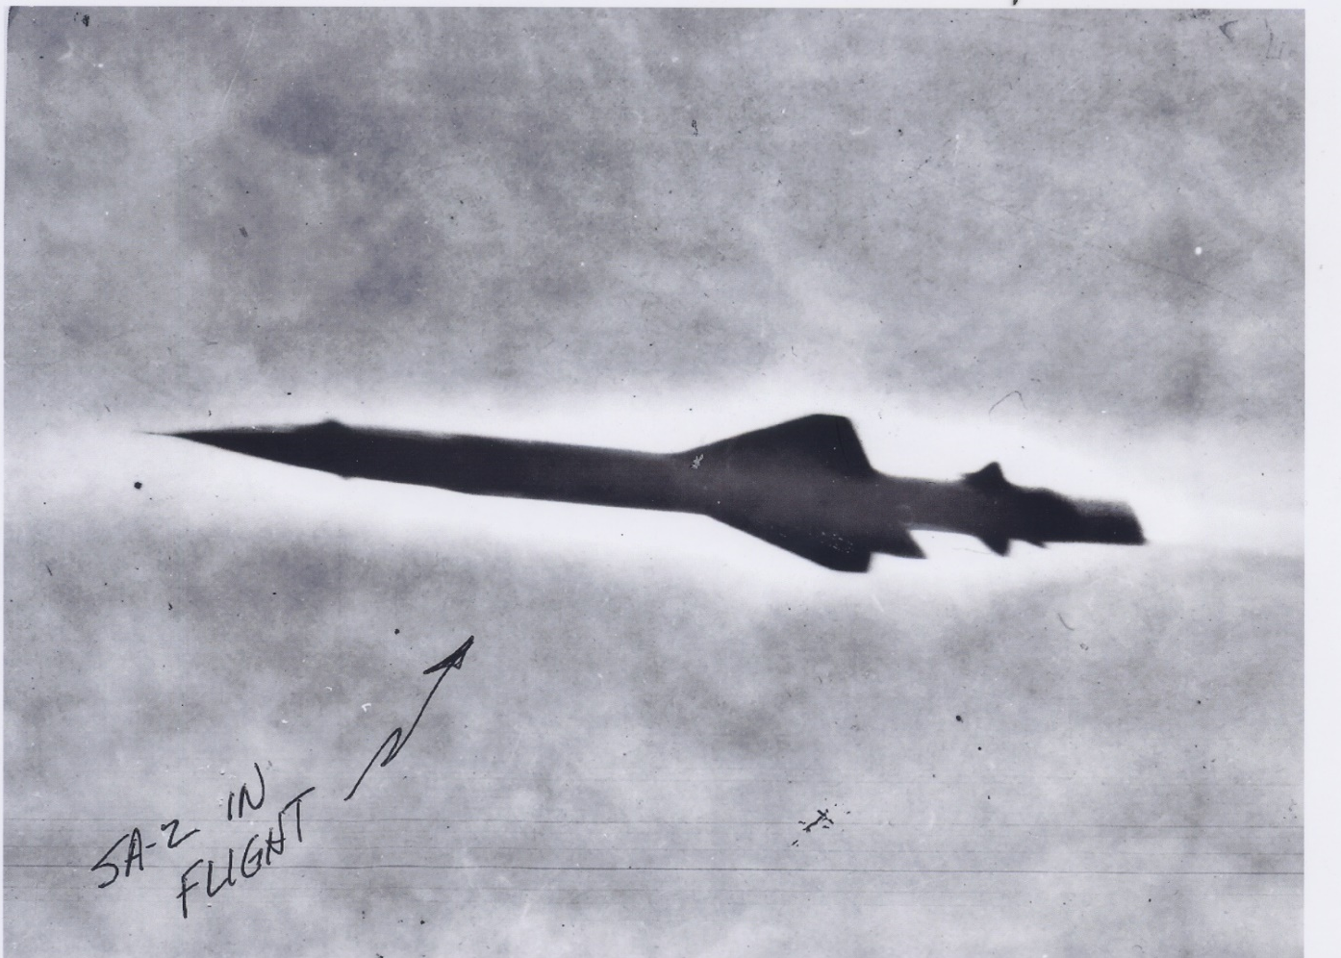
SA-2 in Flight
Notes:
The flying telephone pole

Slide 23
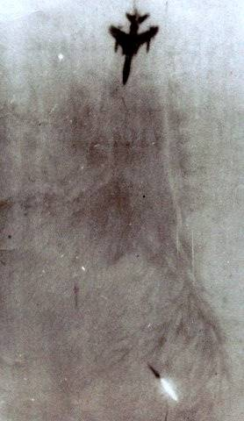
SAM Targets a THUD

Slide 24
Operation Spring High – Iron Hand 1
Retaliatory Raid for 24 July Sam Kill
NVN Forewarned of Mission
Mission Frag released to SVN Hqtrs
48 F-105D’s to attack Sam Site 6 & 7
- 350 Kts @ 50’, CBU-2 & Napalm
-24 Takhli Thuds & 24 Korat Thuds ( 2 abort)
6 Thuds lost attacking dummy sites
Would lead to Dempster Committee
-- Creation of the Wild Weasels

Slide 25
Dempster Committee- Answering the Threat
Locate the Threat
Use Two Seat Fighter Aircraft
Project Wild Weasel
Jam the Threat
Notes:
The Dempster committee formed Aug 3rd 1965, recognized that the Fansong Radar controlling the SA-2, was the key to the solution… It put out signals that could be intercepted… some secret boxes that had been designed for CIA U-2’s were the answer… ATI had commercial boxes ready to go… signed the poloroid pix of the blackboard discussions as the contract. Called Project Wild Weasel…. Was going to call it Mongoose or Ferret but these names had been previously used. Quickly using QRC procedures in configuring F-1OOF two seaters.. Trained at Eglin against a SADS simulator…..

Slide 26
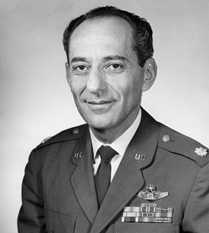
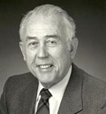
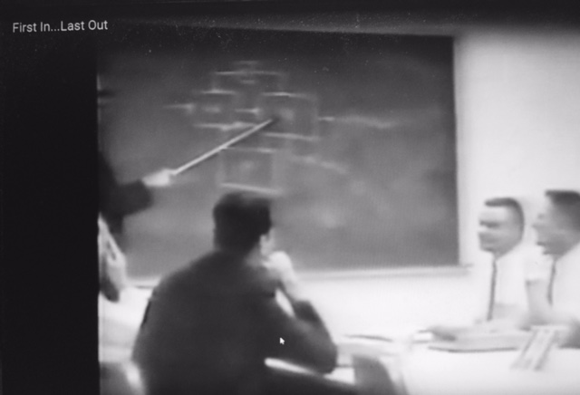
Dempster Committee
L/C Pierre Levy
Dr. John Grigsby
Pentagon Blackboard –working the problem

Slide 27
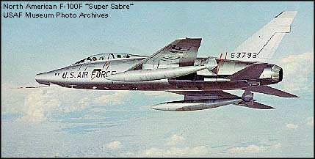
F-100F Wild Weasel I
F-100F
Two Seat Fighter
Just couldn’t keep up with the newer fighters.
Notes:
420 knots when the thuds were doing 560+

Slide 28
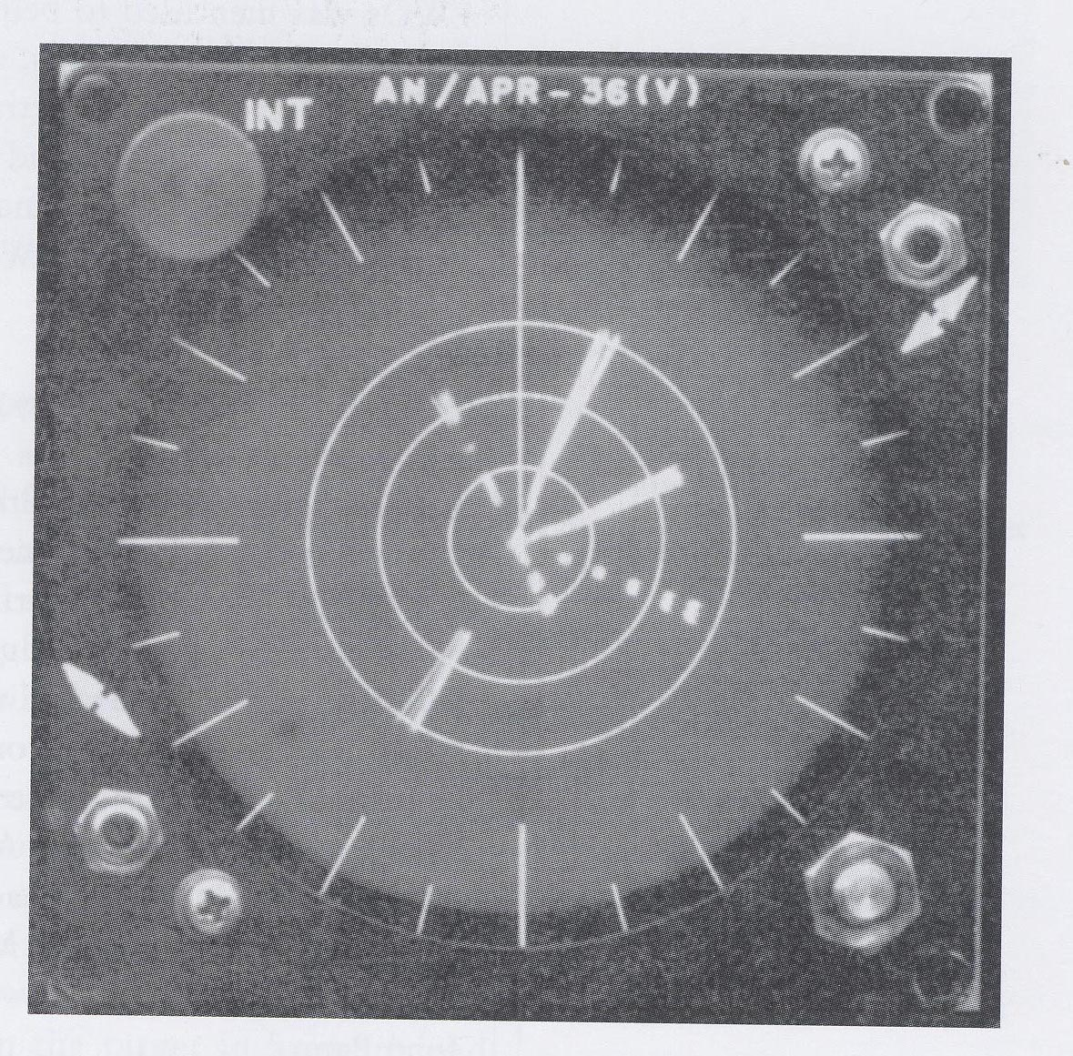
Radar Homing & Warning Rx
Notes:
The off the shelf ATI RADAR HOMING AND RX. ORIGINS IN CIA U-2 PROGRAM.
E BAND CBAND AND I BAND DIRECTION AND DISTANCE…WITH THE LAUNCH WARNING RX IT WAS THE BACKBONE OF THE SYSTEM…..

Slide 29
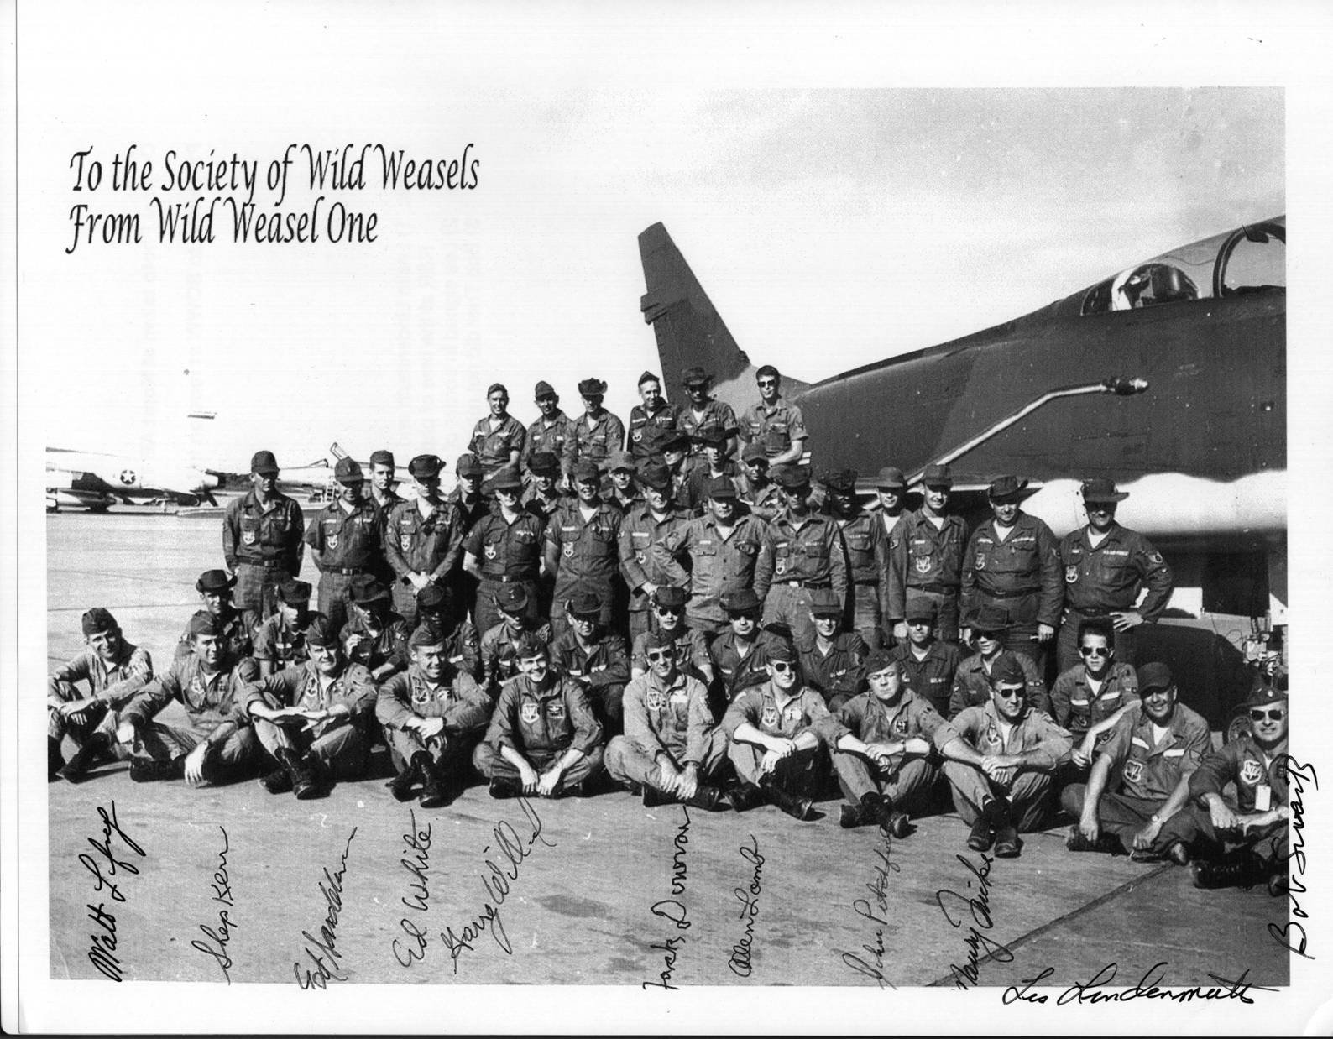
Wild Weasel I – the Pioneers
Notes:
Here are the first Wild Weasels…..Selection process called for the most highly experienced fighter pilots and B-52 EWO’s. One day a call is made…..

Slide 30

Wild Weasel Motto
YGBSM
This is the Weasel motto. It was the words of the first Electronic
Warfare Officer (EWO) when he was told what the mission
was going to be. Get in the back seat of a F-100F and attack SAM Sites.
Quote “You Gotta Be Shitting Me!!!!”
ng
Notes:
HERE IS THE MOTTO OF THE WEASELS UTTERED BY JACK DONOVAN, UPON HEARING WHAT THE MISSION ENTAILED….REMEMBER THESE EWOS/BACKSEATERS HAD COME OUT OF B-52’S AND HAD NEVER BEEN INVERTED OR PULLED MORE THAN TWO “G’S”

Slide 31
The Wild Weasel Mission
Iron Hand
  Strike support First in, Last Out
Hunter Killer
  Troll for Sams
SEAD (Suppression of Enemy Air Defenses)
Notes:
Tactics were developed on the fly.. Each of the early crews would try differerent tactics to try and locate and destroy the SAM SITE.. It was trial by fire..

Slide 32
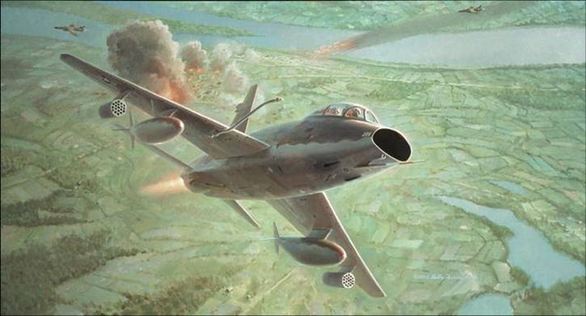
First Sam Kill- 12-22-65
Notes:
On 22 December 1965 Nose gunner Al Lamb and his Bear Jack Donovan leading a flight of 4 Thuds locate and attack a Sam Site

Slide 33
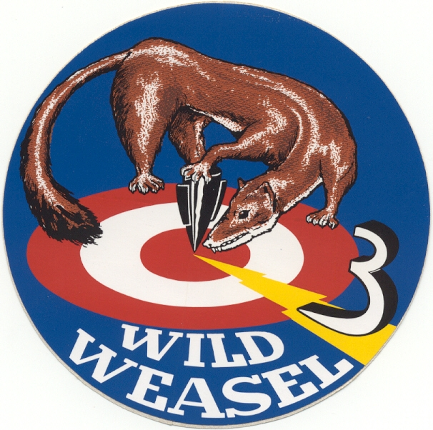
WW III
F-105/F
CREW Selection
Training
Weapons
Tactics

Slide 34
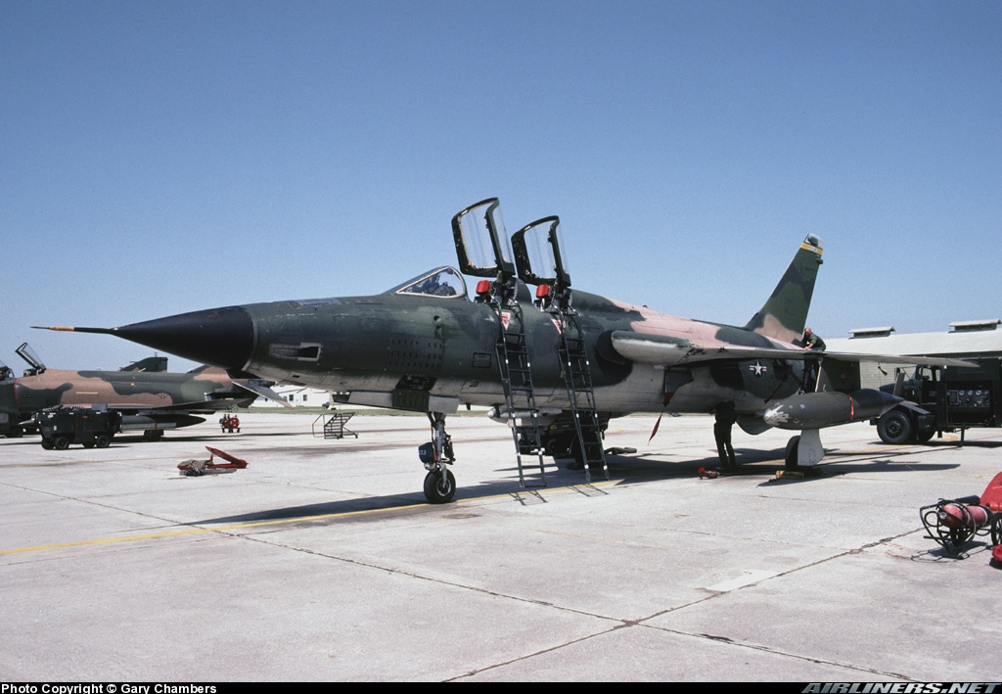
Wild Weasel III The F-105F
Notes:
Notice the tail number 424 Crown Seven … this was the aircraft assigned to John Revak and Stan Goldstein at Korat in 1968, initally 12 f models were configured… then another 18. final total was 86

Slide 35
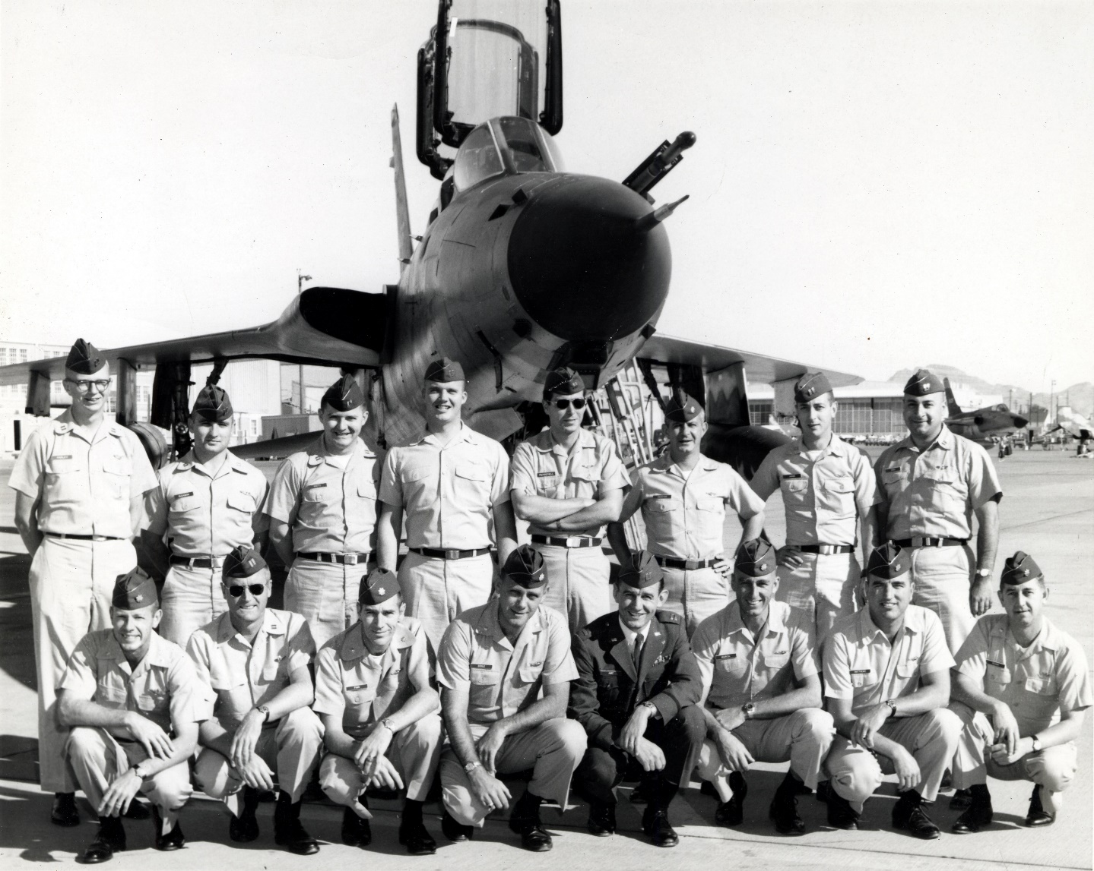
My Wild Weasel Class Nov ‘67

Slide 36
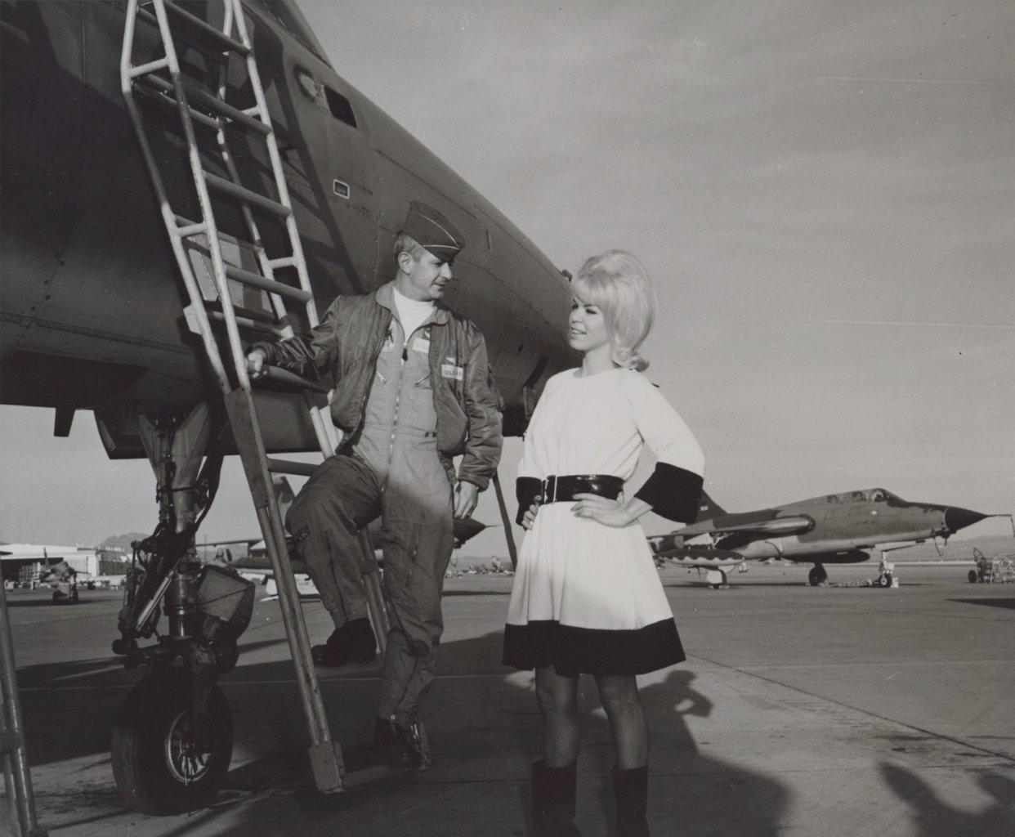
Kitty the Cat Girl & Graduation

Slide 37
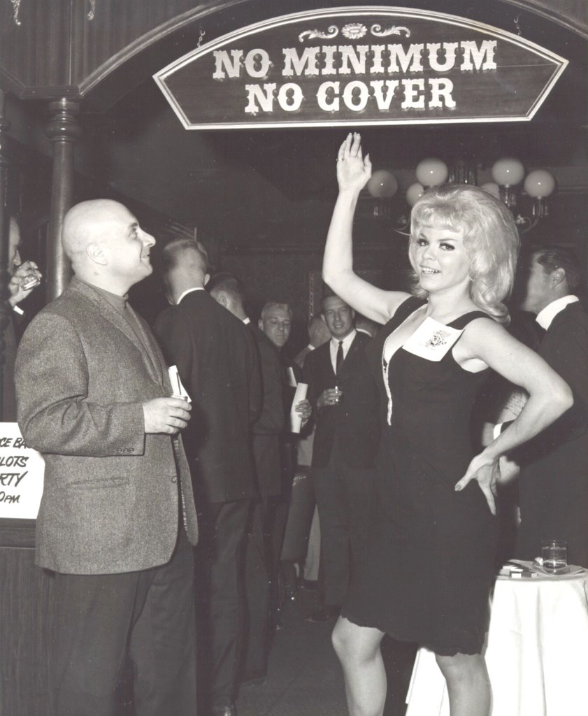
Dave always watches the figures

Slide 38

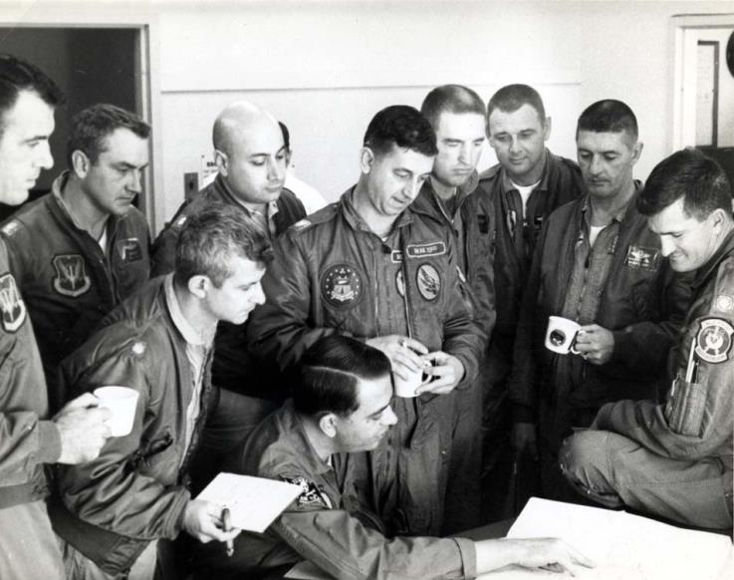

Slide 39
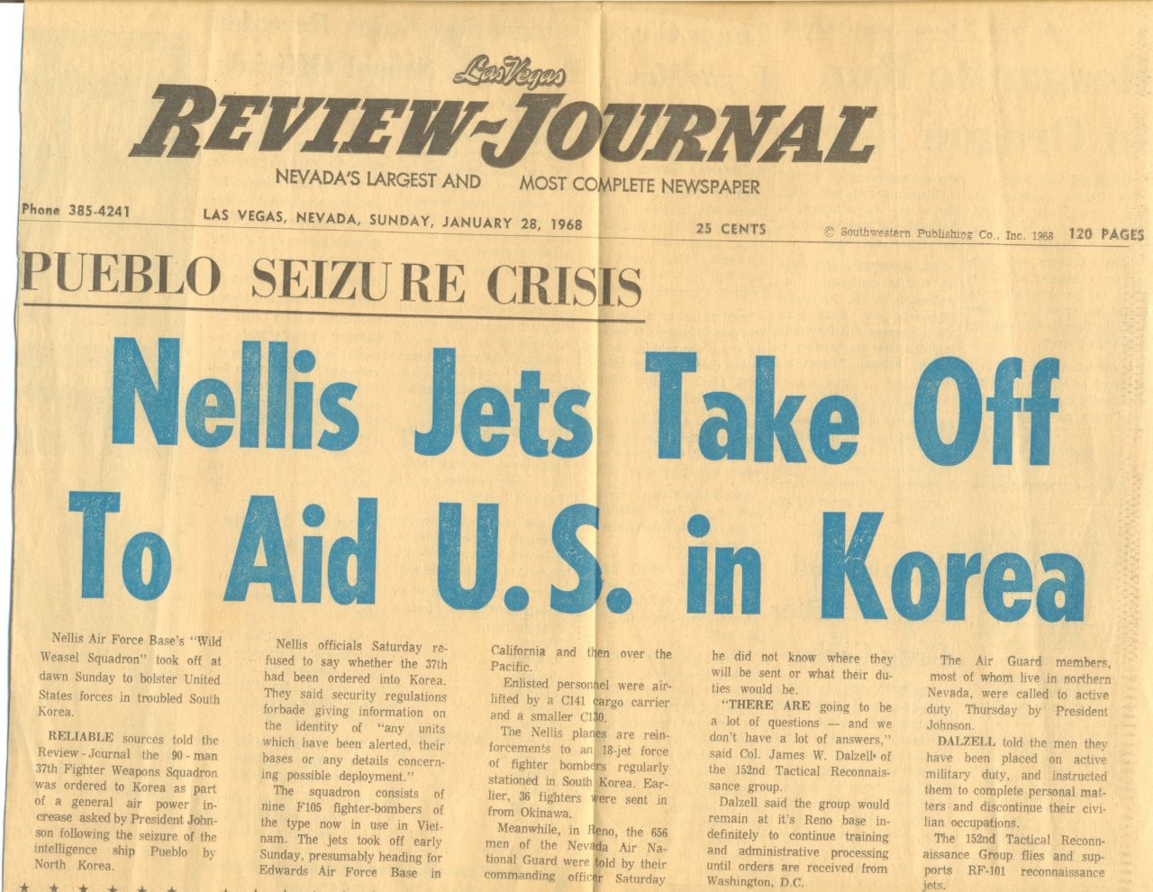
Weasel Class & the Pueblo Crisis

Slide 40
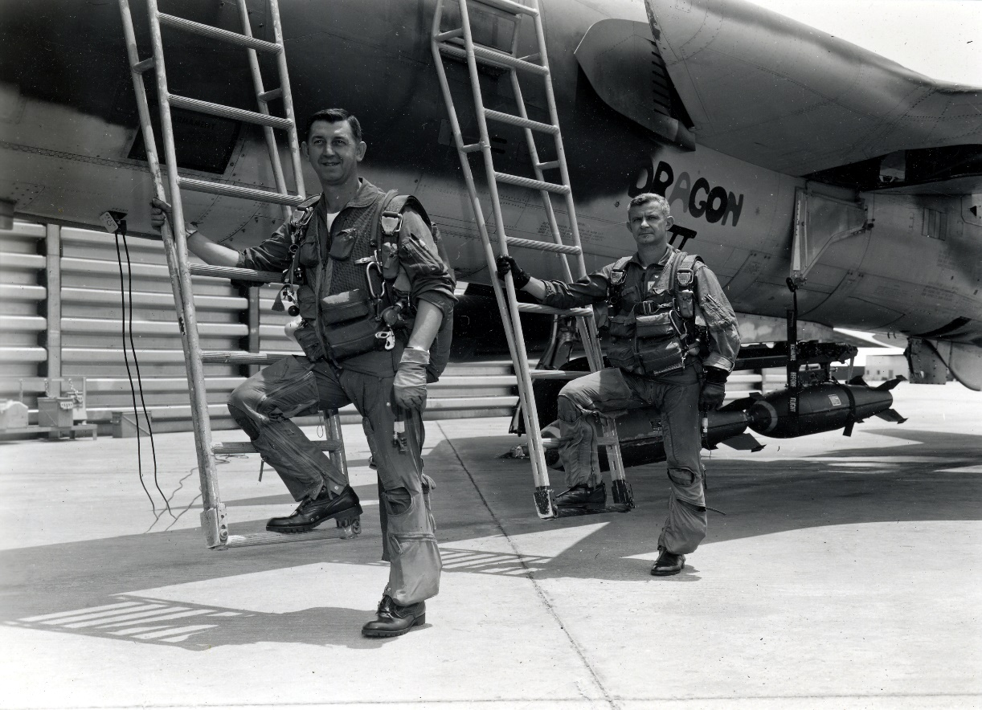
John & Stan –A CREW
Notes:
A marriage made in Heaven and NYC Two Batchelors from NY form a crew and a life long friendship

Slide 41
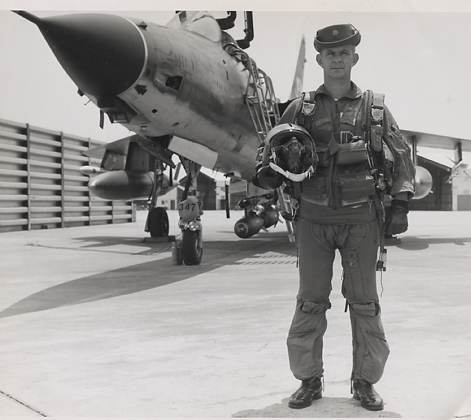
Korat RTAFB March 1968

Slide 42
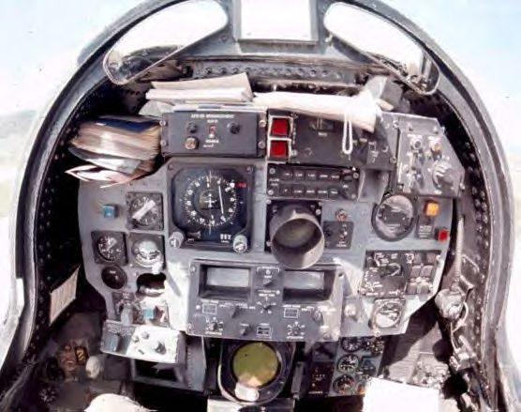
F-105F Rear Cockpit
My office

Slide 43
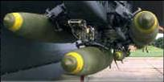
Conventional Bombs
Notes:
Convention bombs come in different sizes 250,500,750 all the way up to 2000 pounds… we ran out of bomb casings during the war… having sold them off as no longer needed to the germans in the early 60’s since we were only going to fight a nuclear war….

Slide 44
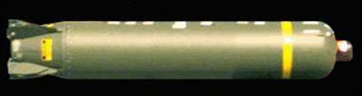
Cluster Bomb Unit
Contains many small bomblets

Slide 45
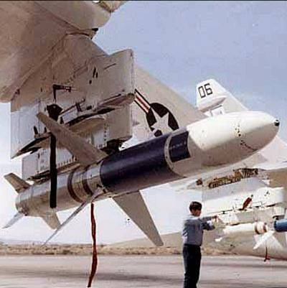
Shrike AGM-45
Notes:
Radar homing on signal of the fansong….. Could also attack other radars in the same signal range…F-100’s received them just before being replaced by WWIII Thuds. Not very accurate if site turned off… out gunned by the sams
Had to change the head to see other radars….

Slide 46
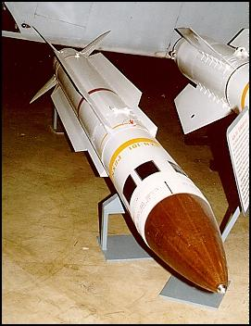
Standard ARM AGM-78
Medium range missile

Slide 47
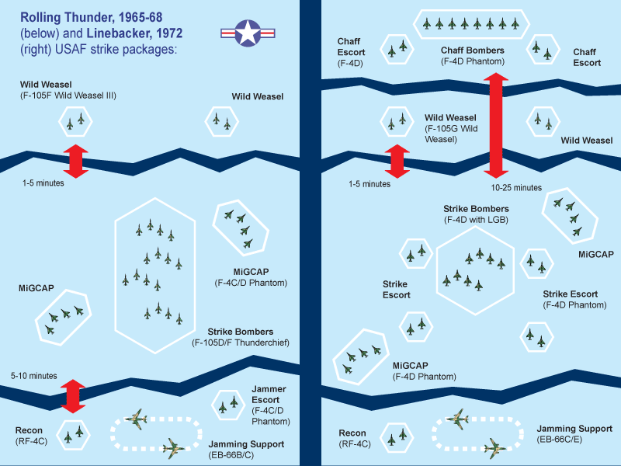
STRIKE FORCE PACKAGE
Weasels (F-105F/G)
Strike force ( F-105D)
MIG Cap ( F-4’s)
Jamming Support (Eb-66)
Recon (RF-4C)
Tankers ( KC-135)
SAR & Jolly Greens
ABCCC ( C-130)

Slide 48
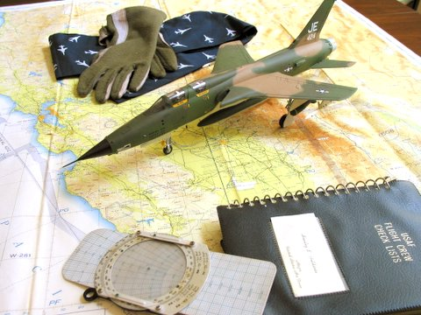
Planning the Mission

Slide 49
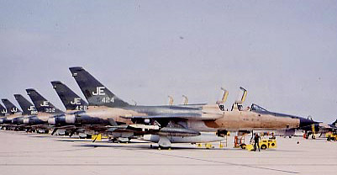
Weasels on the flight line

Slide 50
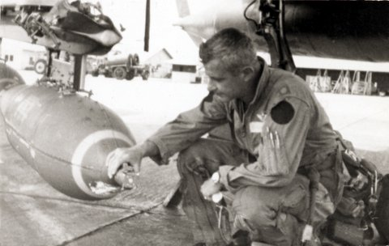
Preflighting Weapons
Notes:
Here I am preflighting a cbu fuse setting, Since my parachute is not on, I can tell that my pilot and I are the spare a;c for this mission.

Slide 51
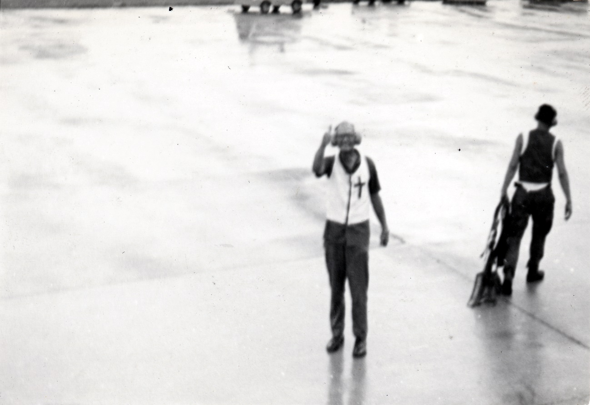
Taxiing out with a little help

Slide 52
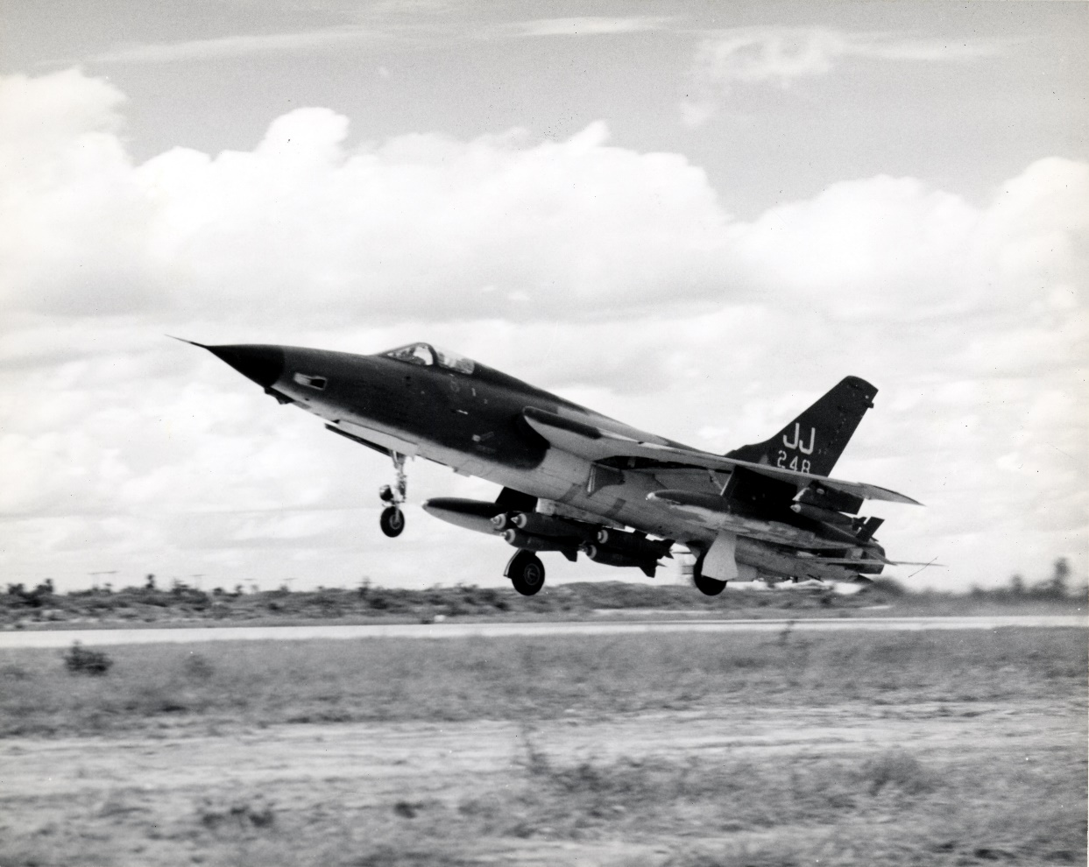
The Strike Launches
Off to join up and meet the tankers

Slide 53
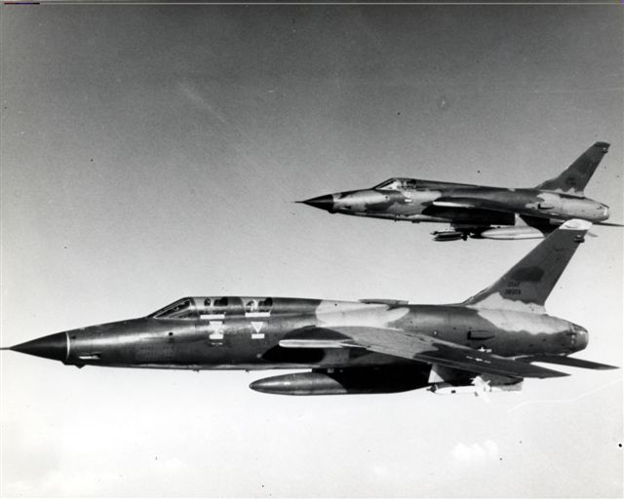
Thud WW with Thud D Wingman
Notes:
To maximize capability and ordnance. Would sometimes pair a F-105D with hard bombs and Cbu’s with the Weasel… D model would roll in on the Sam site after marking by the Weasel
Also notice the F model is prettier and 39 inches longer than the D

Slide 54
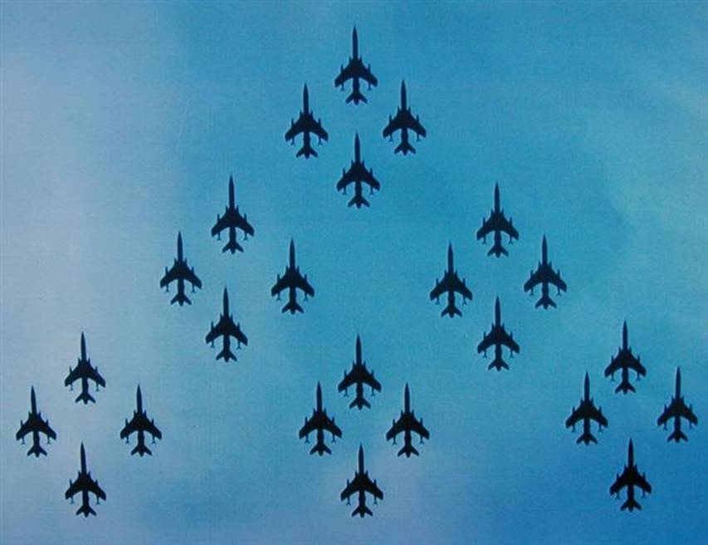
Strike Package

Slide 55
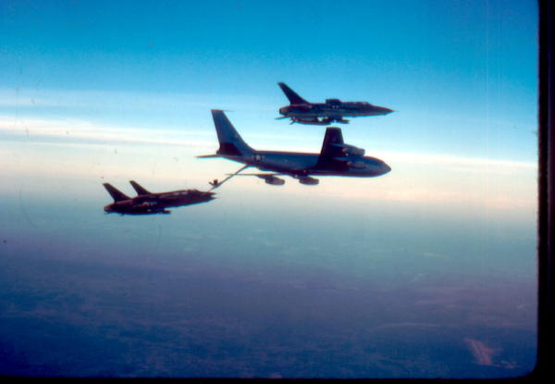
KC-135 with Four Ship

Slide 56
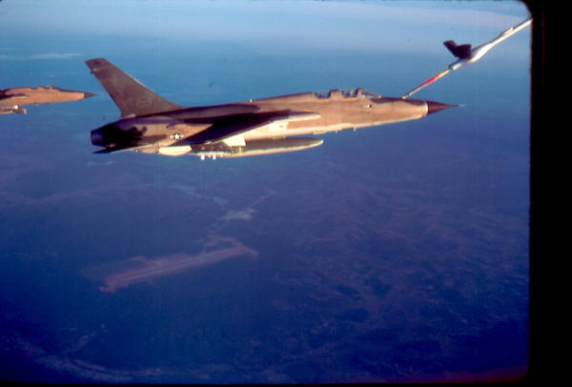
Taking on Fuel –

Slide 57
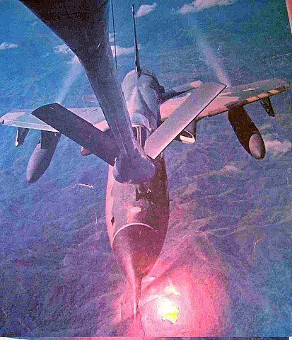
View from the KC-135 Boomer

Slide 58
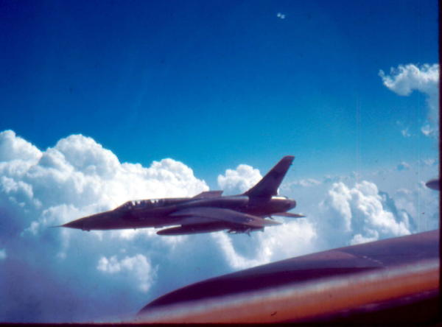
After Refueling- its off to the Pack

Slide 59

Enroute to the Pack

Slide 60

Attacking off of Thud Ridge

Slide 61

Weasel Kills MiG -MOH
Notes:
Leo thorsness shoots down Mig-17 with cannon as it tries to strafe wingmen crews in their parachute. Shot down by MIG-21 11 days later…and becomes POW. Awarded Medal of Honor, but does not find out until he comes home in 73

Slide 62


Wild Weasel MOH Recipients
Leo Thorsness
Merlyn Dethlefsen

Slide 63

Hunter Killer Mission

Slide 64

A Dead Fansong
Notes:
When things go right….A dead Fansong radar….( actually in egypt)

Slide 65


Other Weasel Missions
Notes:
In addition to attacking sam sites… the Weasels because of their two man crew and radar were chosen to attack the enemy at night, keeping pressure up on the Enemy Air Defenses… This program was known as Commando Nail or Ryan’s raiders by the Crews in ‘honor of the AF C/S John Ryan

Slide 66

Running Interference for the Buffs
Notes:
Iron hand missions were always on station in the lower route packages when the B-53 arc lite drops were carried on. No Weasels and they would cancel.. The B-52 flying at 30K feet were un heard and unseen and was the most feared weapon……

Slide 67

Celebrating 100 Missions

Slide 68

Big Brass Ones

Slide 69
Viet Nam Air Losses
3322 Aircraft Lost
  205 by SAM’s
  90 by MiG’s
3265 Fatalities
497 POW’s

Slide 70

WW V F-4G
AGM –88 HARM, AGM-65 Maverick, AGM-78 Standard ARM and AGM-45 Shrike
Notes:
Here is an F-4G the most potent Weasel ever fielded…. Used in Desert storm , no a/c were ever lost when the Gweasel was on scene.

Slide 71

The Tradition Carries on
Notes:
Same motto ,YGBSM latest aircraft the F-16 C/J

Slide 72

Today's Wild Weasel
F-16C/J

Slide 73


Slide 74

I was Replaced by the HTS

Slide 75

Modern SAM
SA-6
Semi-Active Guidance
Mobile – not fixed
At the time, the F-4G was the only weapon system that could find and destroy mobile SAMs.

Slide 76



. Desert Storm SAM Threats
SA-8
SA-3

Slide 77

CURENT THREAT SA-300

Slide 78

F-35 WW VII Capable

Slide 79

F-35 Mission Set

Slide 80
Radar Homing & Warning Rx
Notes:
The off the shelf ATI RADAR HOMING AND RX. ORIGINS IN CIA U-2 PROGRAM.
E BAND CBAND AND I BAND DIRECTION AND DISTANCE…WITH THE LAUNCH WARNING RX IT WAS THE BACKBONE OF THE SYSTEM…..

Slide 81

F-35 COCKPIT DISPLAY
C:/Users/Stan Goldstein/OneDrive/Pictures/Screenshots 1/Screenshot (19).png
C:/Users/Stan Goldstein/OneDrive/Pictures/Screenshots 1/Screenshot (19).png

Slide 82

Wild Weasel Program Evolution
WW I F-100F
WW II F-4C
WW III F-105F/G
WW IV F-4C
WW V F-4G
WW VI F-16C/J
WW VII F-35

Slide 83
Billy Sparks Closing Quote
Being a Wild Weasel at Takhli was, in my opinion, the single most important thing I have ever done. The mission was demanding, dangerous and those of us there performed at a level I have never seen before.

Slide 84
INFORMATION SOURCES
First In, Last Out—Col. Ed Rock
Gradual Failure—Jacob Van Staaveren
Iron Hand –Anthony Thornborough
Vietnam Air Losses – Chris Hobson
Wild Weasel- Larry Davis
Hunter Killers – Dan Hampton

Slide 85


Slide 86

Warts on a Frog

Slide 87

SoWW Memorial Bench - AF Museum

Slide 88

Jack and Allen

Slide 89

Wild Weasel Society
Membership is open to Wild Weasel
Pilots, Electronic Warfare Officers,
and Maintainers.
http://wildweasel.org

Slide 90

Red River Valley Fighter Pilot Association
This association was initially formed from Fighter Pilots who flew during the Vietnam War.
Now opened membership to All US Aircrew members.
http://www.rrva.com

Slide 91

New Home of the Wild Weasel

Slide 92

AF Museum WW Commemoration

Slide 93
WW I Continues to Contribute
Development of WW I used as a teaching tool to young Acquisition Officers
-Change the formal culture
-Get things done quickly
-Don’t aim for perfection
-Adapt existing systems
-work with outside agencies not just contractors
-Early Testing- Fly before buy

Slide 94
Working the Wild Weasel Issues
- ALSS, PELSS , PLSS
-WHAT WOULD NEXT WEASEL BE (F-4D FIASCO)
-25% OF ALL FIGHTERS TO BE WEASELS (116 F-4G'S)
-PENTAGON WEASEL MAFIA
-WILD WEASEL DOCTRINE

Slide 95

Passing the Baton to the 20FW

Slide 96

50th Reunion Wild Weasel Flash

